Slide 1

Yogo: You Only Grep Once
Semantic Code Search via Equational Reasoning
Pond Premtoon
James Koppel
Armando Solar-Lezama
MIT CSAIL
Notes:
Hello. I'm Pond Premtoon, and I'd like to talk about a new semantic code search
technique and also an implementation that we called Yogo. I worked on this
project with my mentor Jimmy Koppel and my master's thesis advisor
Armando Solar-Lezama at MIT CSAIL.

Slide 2
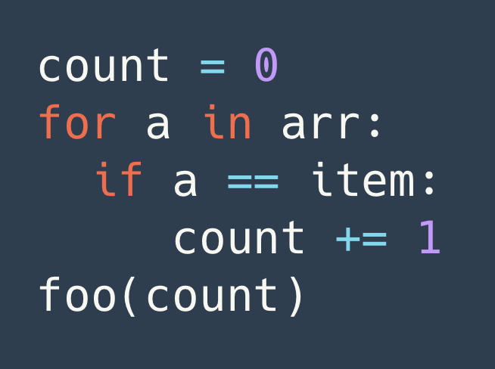
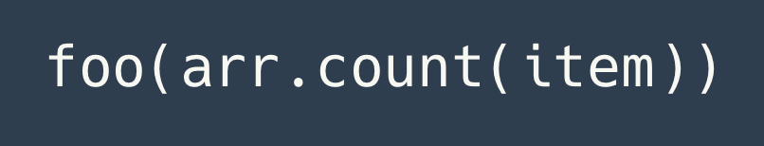

Once upon a time
Notes:
When I started learning python, I wrote this code a bunch of times. This is a very manual way of counting how many times item occurs in a collection ’arr’.
But eventually I learned a different way of doing it.
Imagine if I had a codebase or a project, and I wanted find all the places I have written this loop so that I can change it.
Already this is this is going to be pretty tedious, but the hard thing is, I’m not just looking for this exact text

Slide 3
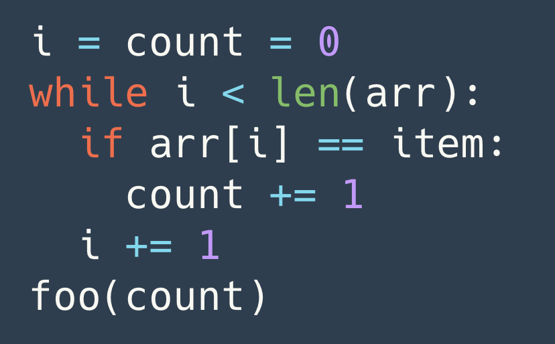
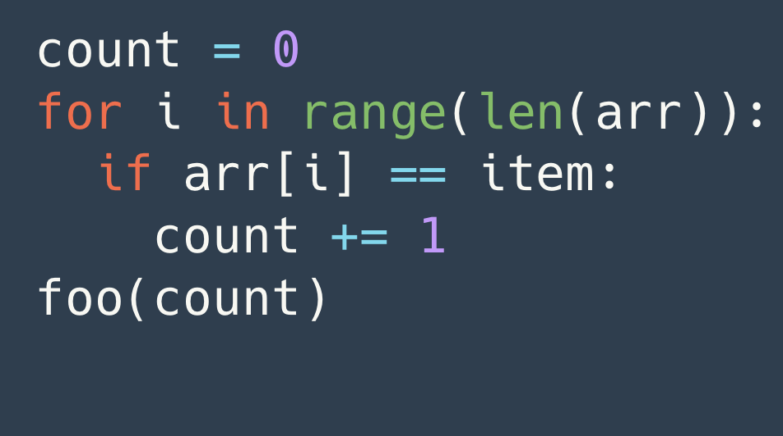
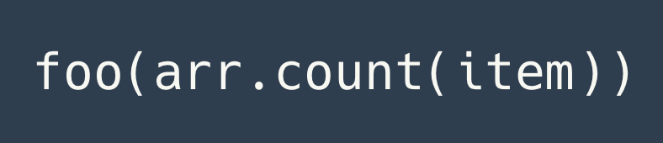
Finding its “paraphrases”
Notes:
I also want to find these other silly ways of writing that loop
I may even want this one to show up in my search result, may because I’m doing this search for a different reason
The important thing is, these code samples are concrete ways of doing abstractly the same thing.
But most search tools just don’t understand that.

Slide 4
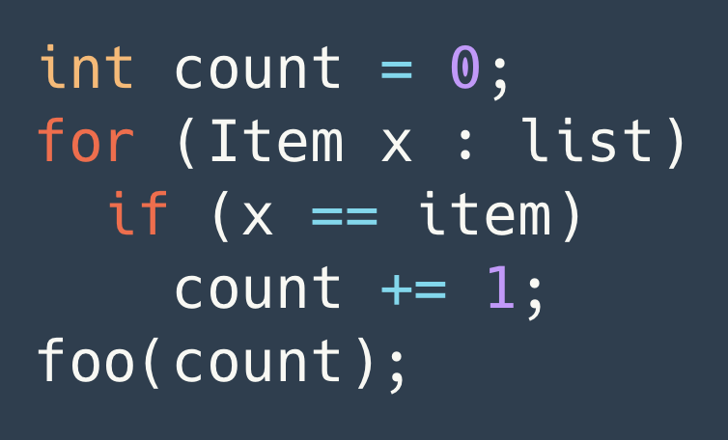
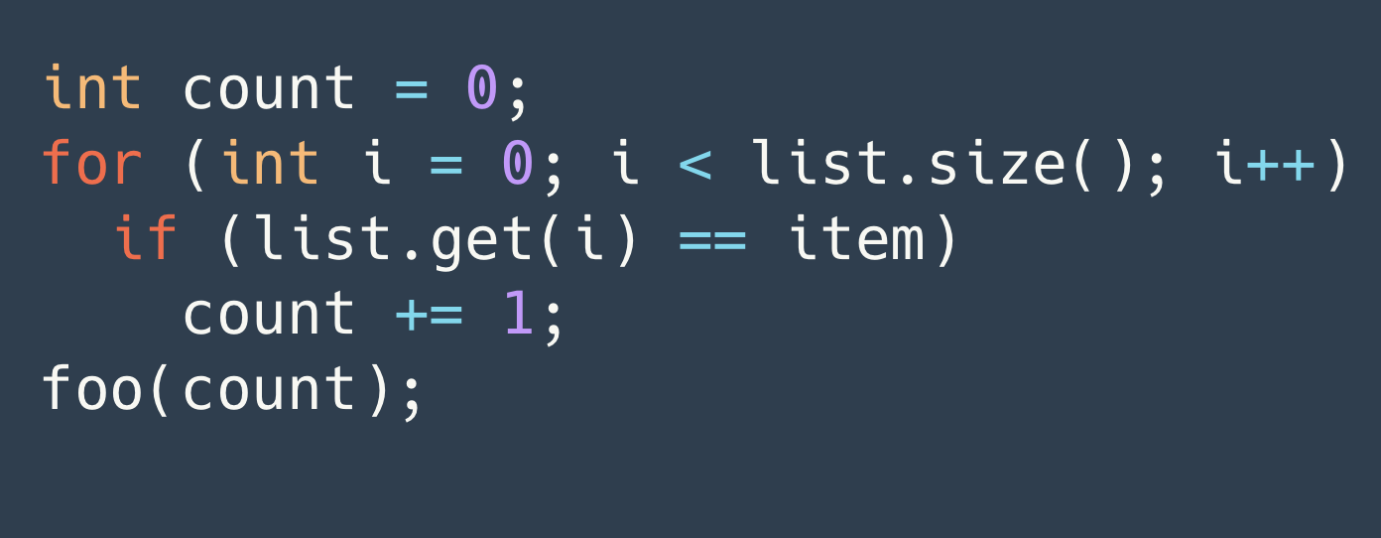
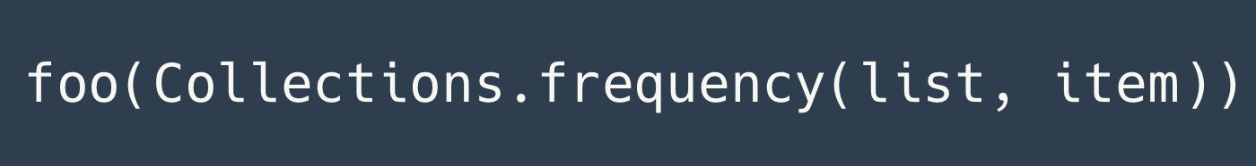
Java
Notes:
In fact, what if I want the find the same computation in more than one language.
For instance, the array item count pattern is hardly unique to python. These are Java examples.

Slide 5
We reviewed 70 search tools.
None could handle it.
Notes:
We looked at 70 different search tools
And none of them could match all these code paraphrases consistently or correctly enough, even within one language

Slide 6
Semantic Search:
Concepts, not just text or syntax
Notes:
So this really shows the need for a new search technique that really understands computations or abstract concepts,
and can reason about how they might surface differently.

Slide 7
Roots
Equality Saturation
Tate et al, 2009
Programmer’s Apprentice
Rich and Waters, 1988
Program Expression Graph
Equational Reasoning
Representing Abstractions
Notes:
From the work of Ross Tate and Colleagues in 2009, we borrow
A way to represent a program as a graph of pure expressions,
and an efficient way to reason about different but equivalent expressions using a system of rewrite rules
From the Programmer's Apprentice project, we drew the insight that we can bridge very different paraphrases by representing the abstract concepts that they commonly implement

Slide 8
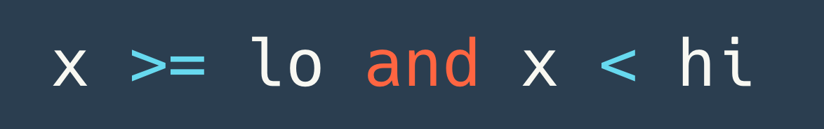
Program Expression Graph (PEG)
x
lo
hi
>=
<
and
Notes:
-

Slide 9
Search Pattern: Bound-checking
Pattern: x >= xlo and x < xhi
Must match same node
(defsearch bound-checking
(root <- (binop :and (binop :>= x xlo)
(binop :< x xhi))))
Notes:
- “domain specific language”

Slide 10
Program Expression Graph (PEG)
Pattern: x >= xlo and x < xhi
x
xlo
xhi
(defsearch bound-checking
(root <- (binop :and
(binop :>= x xlo)
(binop :< x xhi))))
x
lo
hi
>=
<
and
root
Notes:
- Underscore and dashes

Slide 11
Program Expression Graph (PEG)
Pattern: not (x >= hi or x < lo)
x
lo
hi
>=
<
and

Slide 12
Equality Saturation
De Morgan’s Laws: a and b => not ((not a) or (not b))
(defeqrule de-morgans-1
(binop :and a b)
=>
(unop :not (binop :or (unop :not a) (unop :not b))))

Slide 13
Equality Saturation
Rules:
a and b => not ((not a) or (not b))
x
lo
hi
(not (a >= b)) => a < b
lo
>=
<
x
(not (a < b)) => a >= b
<
not
not
>=
or
and
not
Notes:
- don’t narrate the bottom two rules

Slide 14
Equality Saturation
Pattern: not (x >= hi or x < lo)
x
lo
hi
lo
>=
<
x
<
not
not
>=
or
and
not

Slide 15
Equality Saturation
Pattern: not (x >= hi or x < lo)
x
lo
hi
lo
>=
<
x
<
not
not
>=
or
root
Root node corresponds
to no AST nodes
and
not

Slide 16
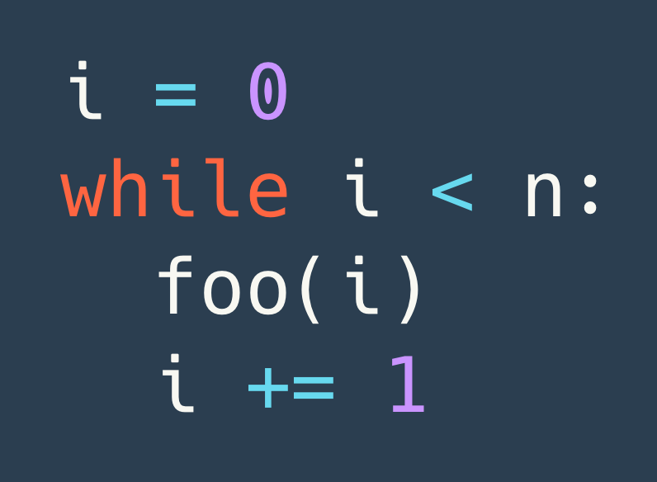
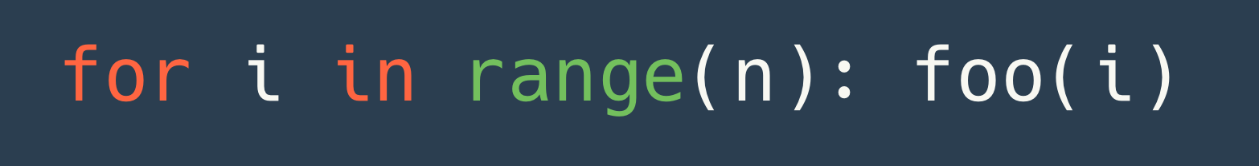
Loops?

Slide 17
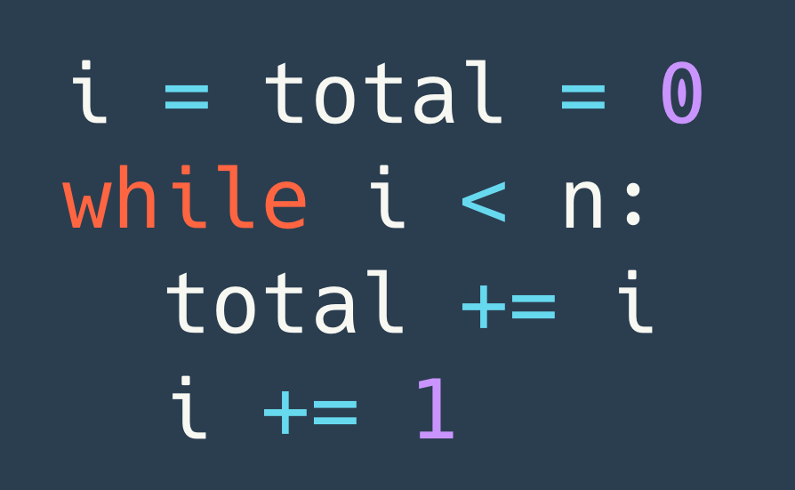

Representing loops as expressions
total
i
0
1
+
+
total
0
i
+
+
loop
loop
1
+
+
+
+
Notes:
- Everything can be represented as pure functional expressions

Slide 18
Iterator-style loops
range
n
fcall
iterV
Notes:
"One main improvement.."
without compiling

Slide 19
Representing Abstractions
More concrete
More abstract
More concrete
0
0
1
range
n
loop
1
seq
fcall
+
iterV
iterV

Slide 20
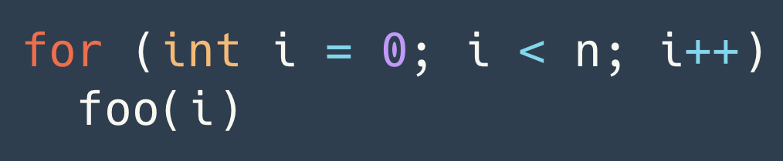
Cross-Language Paraphrases
0
1
seq
iterV

Slide 21
Extensible and Reusable Hierarchy
mean
More abstract
More implementations
each rule targets
sum
iter-array
iterV
+
seq
+
array-access

Slide 23
Testing our approach

Slide 24
Yogo: You Only Grep Once
Codebase
Yogo
Intraprocedural matches
Rules
Search patterns
Notes:
Intraprocedural
Corners don’t match

Slide 25
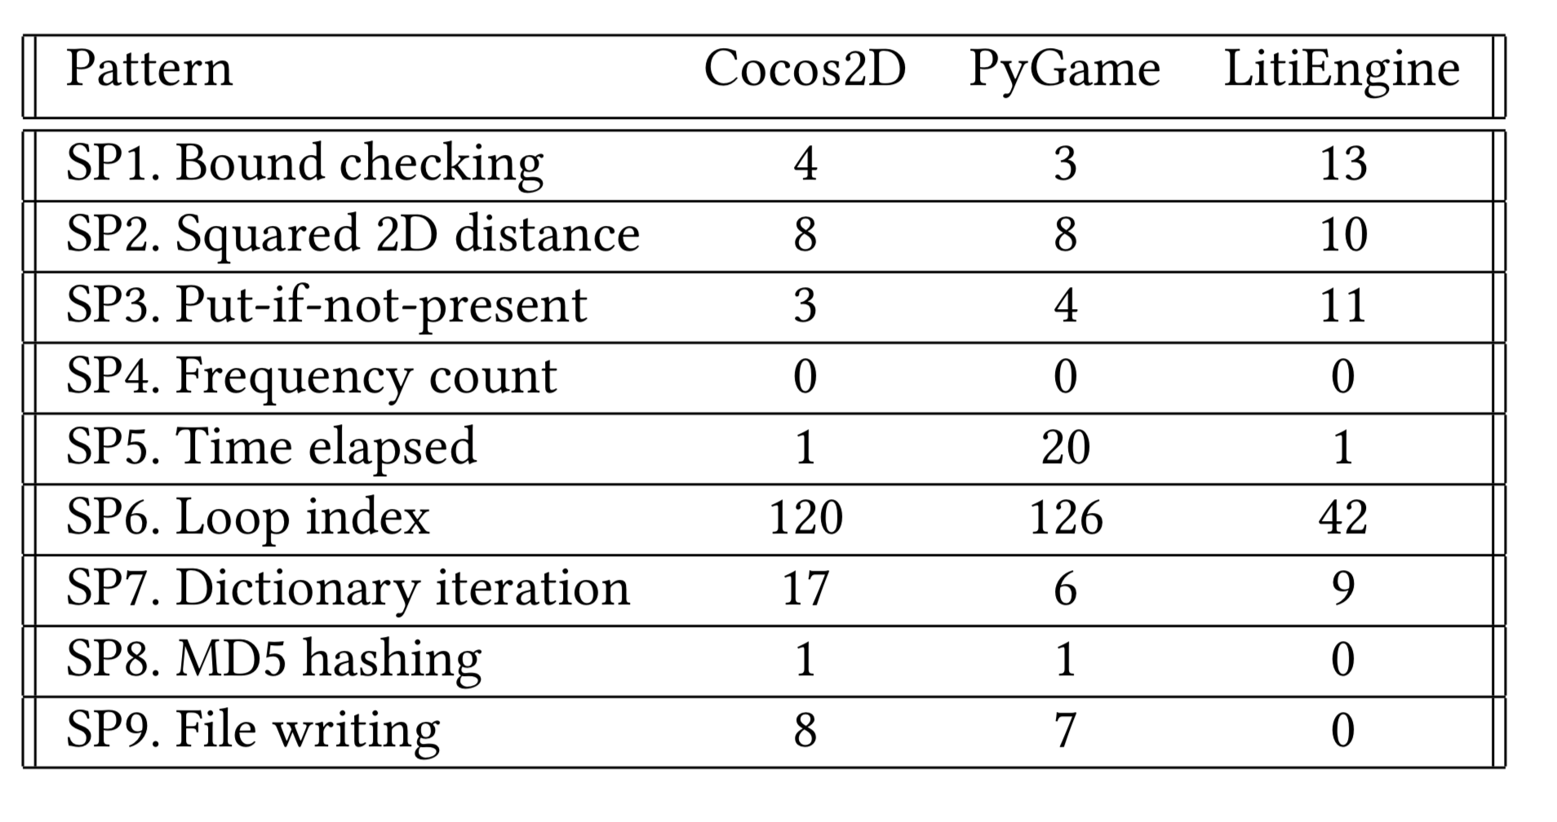
Experiment
See our paper!

Slide 26
Example: 2D Distance Squared
Pattern: (x1-x2)^2 + (y1-y2)^2
(defsearch sp2-distance-sq
(dx <- (generic/binop :- x1 x2))
(dy <- (generic/binop :- y1 y2))
(root <- (generic/binop
:+
(generic/binop :** dx (generic/const 2))
(generic/binop :** dy (generic/const 2))

Slide 27
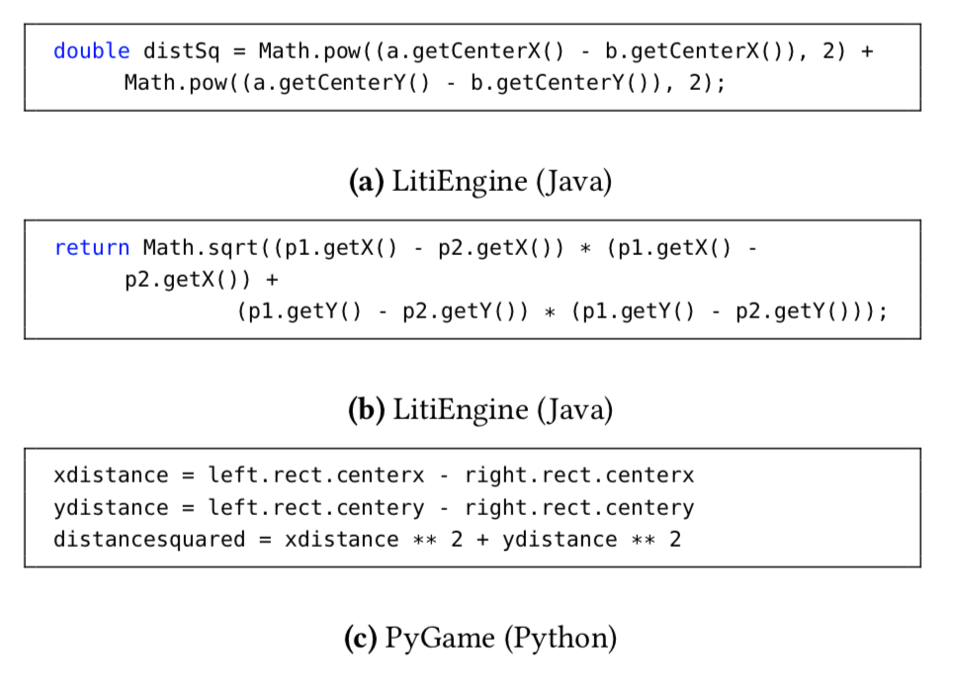
Example: 2D Distance Squared

Slide 28
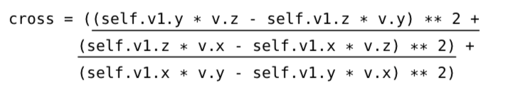
Example: 2D Distance Squared
Pattern: (x1-x2)^2 + (y1-y2)^2

Slide 29
Example: Time Difference
(defsearch sp5-time-diff
(start <- (custom/read-time _))
(end <- (custom/read-time _))
(diff <- (generic/binop :- end start)))

Slide 30
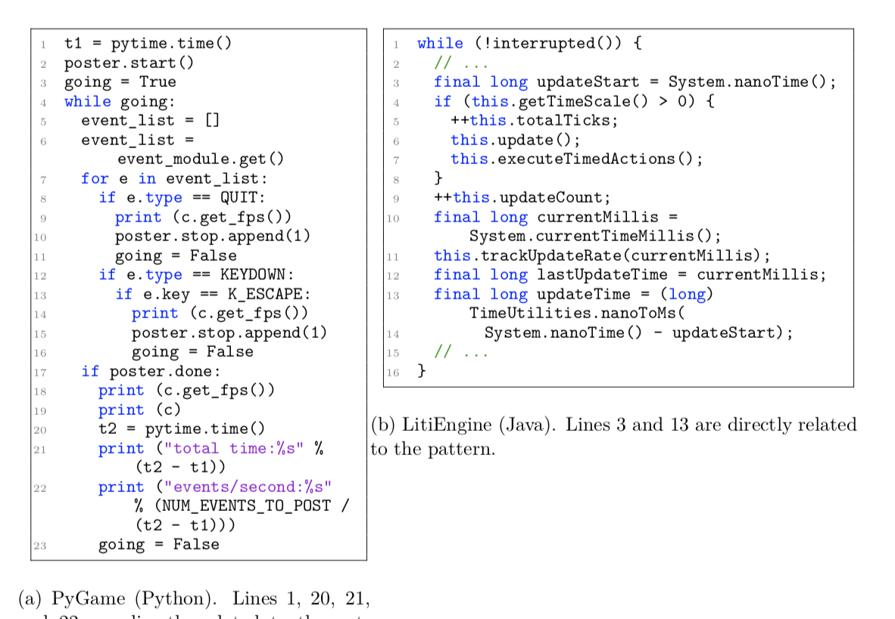
Example: Time Difference
Notes:
- Talk about memory as expressions. We have representations for assignments and function calls, and equality rules

Slide 31
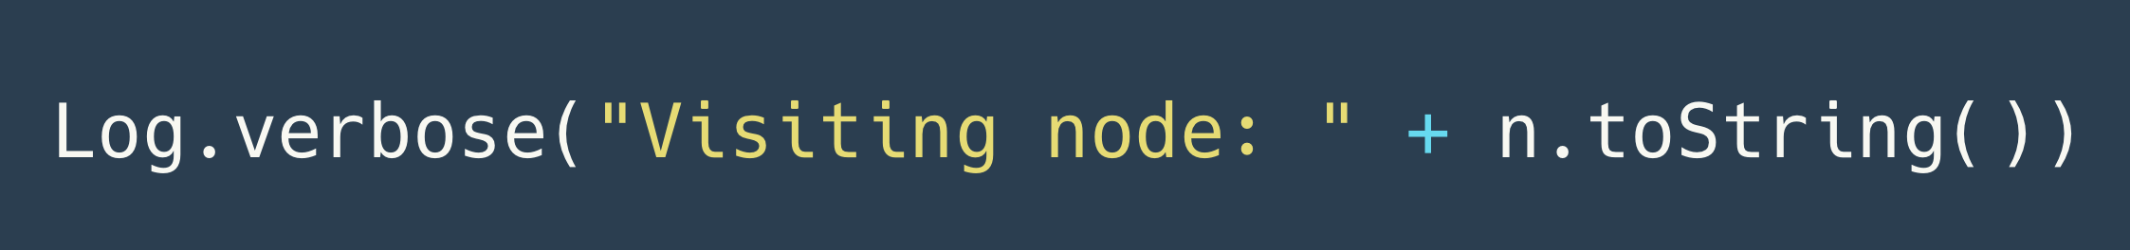
Case Study: Oracle’s Graal Java Compiler
1.2-million-line Java codebase
330-line static analysis code dedicated to finding this pattern

Slide 32
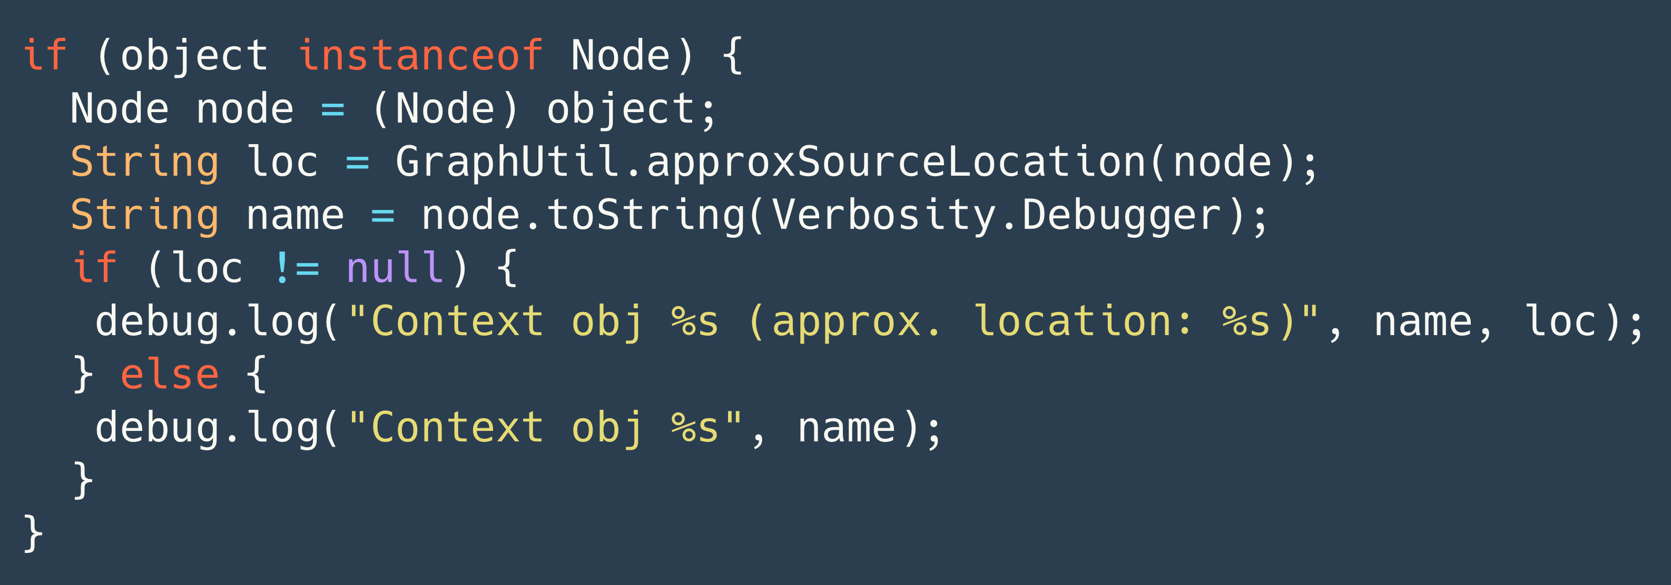
Yogo found what they missed

Slide 33
Yogo: You Only Grep Once
Semantic Code Search via Equational Reasoning
Pond Premtoon
varot@alum.mit.edu
James Koppel
jkoppel@mit.edu
Armando Solar-Lezama
asolar@mit.edu

Slide 34
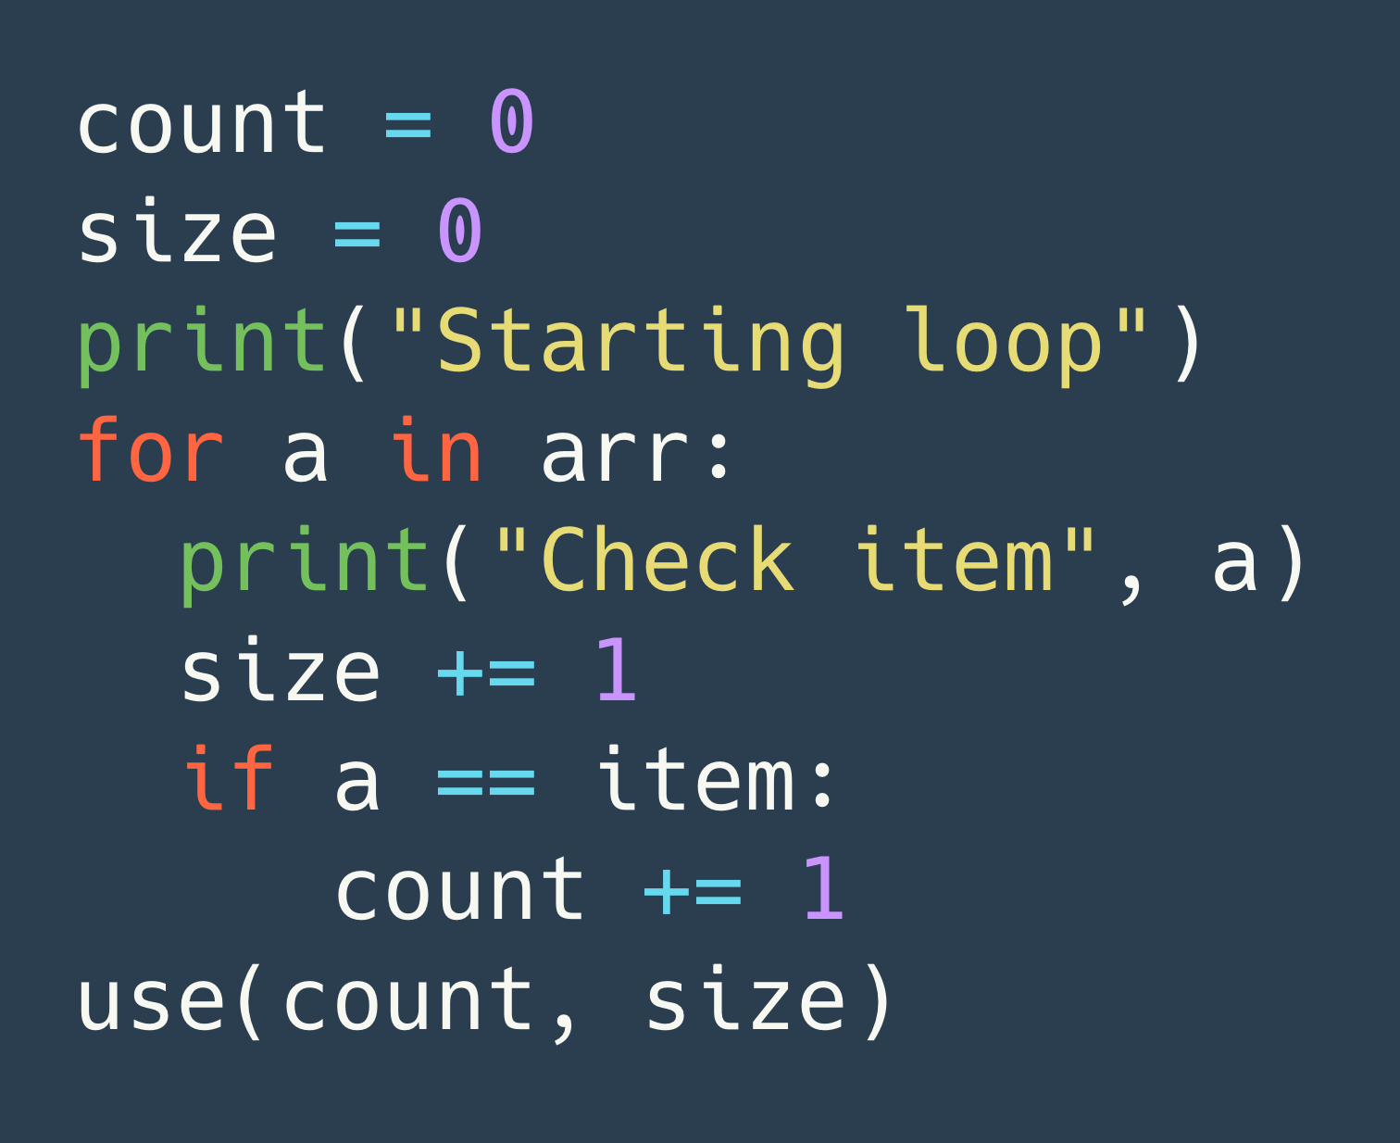
(NOT INCLUDED) Discontiguous Matches

Slide 35
Compose!
(defeqrule array-access-is-iter
(array-access arr (iterV (seq 0 1)))
=>
(iterV arr))

