Slide 1
Capturing the Future by
Replaying the Past
James Koppel, MIT
Gabriel Scherer, INRIA
Armando Solar-Lezama, MIT

Slide 2
Nondeterminism
3
What language
has this
?
choose(3, 4)
4
Splits the world
Returns both

Slide 3
Java Does!
> withNondeterminism(() ->
choose(3,4) * choose(5,6))
→ List([15,18,20,24])
Completely normal
Java program

Slide 4
Delimited Control
(aka Delimited Continuations)
1 + reset {
let x = shift (λ k → 1+k (k 5))
x * 2
}

Slide 5
Delimited Control
(aka Delimited Continuations)
1 + reset {
}
shift (λ k → 1+k (k 5))
let x =
x * 2

Slide 6
Delimited Control
(aka Delimited Continuations)
1 + reset {
}
1+(λ x → 2*x) (λ x → 2*x) 5
→22

Slide 7
Delimited Control
(aka Delimited Continuations)
Traversal
What language
has this
?
1
2
3
4
5
foo
shift
Iterator

Slide 8
Java Does!
> 1+reset(() ->
2 * shift((k) -> k.apply(k.apply(5))))
→ 22
Completely normal Java program

Slide 9
We can do:
• Any monadic effect (callcc, probabilistic programming)
• In direct style (no do-notation, no callbacks)
• In almost any language
(anything with exceptions + state)
Notes:
Replace these images with something that shows an insect next to the butterfly net….maybe

Slide 10
Setup
Fillinski 1994
Delimited control
Any monadic effect
“Delimited control is the mother of all monads”

Slide 11
Setup
Fillinski 1994
Mutable State
Fillinski 1994
Delimited control
Any monadic effect
call/cc

Slide 12
Setup
This work
Mutable State
Fillinski 1994
Delimited control
Any monadic effect
call/cc
Exceptions
Notes:
The bottom

Slide 13
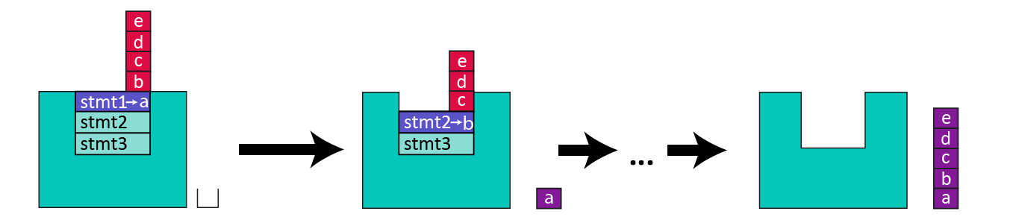
Overview
Replay-Based
Nondeterminism
Thermometer Continuations
thermometer
Special case
Language of Choice:

Slide 14
Replay-Based Nondeterminism: Easiest Version
choose2 (5, 6)
withNondeterminism2 (fn () =>
3 * choose2 (5, 6))
5
6
→ [15, 18]
15
18

Slide 15
Replay-Based Nondeterminism: Easiest Version
val firstTime = ref false
choose2 (5, 6)
fun choose2 (x1,x2) =
if deref firstTime then
x1
else
x2
5
6
15
18
fun withNondeterminism2 f =
[ (firstTime := true ; f ())
, (firstTime := false; f ())]
withNondeterminism (fn () =>
3 * choose2 (5, 6))
→ [15, 18]
Notes:
I got confused about what “!” means in my own talk. Other people certainly will.

Slide 16
Scaling Up
choose [true, false]
choose [7, 8, 9]
withNondeterminism (fn () =>
if choose [true,false] then
choose [5,6]
else
choose [7,8,9])
choose [5, 6]

Slide 17
Scaling Up
Path Index
past
0
2
future
type idx = int
type len = int
val past = (idx * len) stack
val future = int stack
0
2
idx
len
idx
len
withNondeterminism (fn () =>
if choose [true,false] then
choose [5,6]
else
choose [7,8,9])
cur
0
1
cur
0
2
0
1
1
cur

Slide 18
Scaling Up
Path Index
past
1
2
future
type idx = int
type len = int
val past = (idx * len) stack
val future = int stack
0
2
idx
len
idx
len
withNondeterminism (fn () =>
if choose [true,false] then
choose [5,6]
else
choose [7,8,9])
0
1
0
2
0
1
1

Slide 19
Scaling Up
0
2
past
future
type idx = int
type len = int
val past = (idx * len) stack
val future = int stack
1
2
idx
len
idx
len
withNondeterminism (fn () =>
if choose [true,false] then
choose [5,6]
else
choose [7,8,9])
cur
0
1
cur
0
2
0
1
1
cur

Slide 20
Scaling Up
1
2
past
2
future
type idx = int
type len = int
val past = (idx * len) stack
val future = int stack
0
2
1
idx
len
idx
len
withNondeterminism (fn () =>
if choose [true,false] then
choose [5,6]
else
choose [7,8,9])
0
1
0
2
0
1
1

Slide 21
Scaling Up
past
0
3
future
type idx = int
type len = int
val past = (idx * len) stack
val future = int stack
1
2
idx
len
idx
len
withNondeterminism (fn () =>
if choose [true,false] then
choose [5,6]
else
choose [7,8,9])
cur
0
1
cur
0
2
0
1
1
cur

Slide 22
Catches
withNondeterminism (fn () =>
print "Hello";
choose [1, 2])
Prints twice!
Quadratic blowup from replay
(Benchmarks: Not actually that bad)
No native effects

Slide 23
Thermometer Continuations
Notes:
MAKE SURE to REPLACE [] WITH SYMBOL
Use a different color for the things containing “[]” (these are continuations, not normal code)

Slide 24
Nondet: Where are the continuations?
withNondeterminism (fn () =>
(1 + 2) * choose [5, 6])
withNondeterminism (fn () =>
3 * )
withNondeterminism (fn () =>
3 * )
5
6
Continuations
First copy: Keep running the program
Second copy: Replay
Notes:
MAKE SURE to REPLACE [] WITH SYMBOL
Use a different color for the things containing “[]” (these are continuations, not normal code)

Slide 25
Capturing a Continuation
val f = reset (fn () =>
let val x = effectfulFn1 ()
val y = effectfulFn2 ()
val yielded = shift (fn k => k)
in
x + y + yielded
end
)
3
7
f = (fn => 3 + 7 + )
How to represent?
With these

Slide 26
Thermometer Continuations
(fn () =>
let val x = effectfulFn1 ()
val y = effectfulFn2 ()
val yielded = shift (fn k => k)
in
x + y + yielded
end
)
f =
7
3
Function
past
Thermometer Continuation

Slide 27
Thermometer Continuations
(fn () =>
let val x = effectfulFn1 ()
val y = effectfulFn2 ()
val yielded = shift (fn k => k)
in
x + y + yielded
end
)
7
3
Function
past
f 5

Slide 28
Thermometer Continuations
(fn () =>
let val x = effectfulFn1 ()
val y = effectfulFn2 ()
val yielded = shift (fn k => k)
in
x + y + yielded
end
)
5
7
3
Function
past
f 5

Slide 29
Thermometer Continuations
future
5
5
7
7
The state we were looking for
3
3
(fn () =>
let val x = effectfulFn1 ()
val y = effectfulFn2 ()
val yielded = shift (fn k => k)
in
x + y + yielded
end
)
(fn => 3 + 7 + )
3
7
5
Function
past
f 5

Slide 30
Implementing shift
fun shift f =
case pop future of
SOME v => ...
NONE =>
(...
raise (Done result))
cur_fn
past
future
cur_fn
past
reset (fn () =>
shift (fn k => concat [k 3, k 4])
* shift (fn l => [l 5, l 6])
cur_fn
k =
3
Exception
Exception
past
future
cur_fn
3
3
l =
reset (fn () =>
shift (fn k => concat [k 3, k 4])
* shift (fn l => [l 5, l 6])
3
cur_fn
past
cur_fn

Slide 31
Implementing shift
fun shift f =
case pop future of
SOME v => ...
NONE =>
(...
raise (Done result))
concat [k 3, k 4]
cur_fn
k =
cur_fn
3
l =
[l 5, l 6]

Slide 32
Implementing shift
Final answer: [15, 18, 20, 24]
[15, 18]
[20, 24]
fun shift f =
case pop future of
SOME v => ...
NONE =>
(...
raise (Done result))
concat [k 3, k 4]
[l 5, l 6]
15
18
cur_fn
3
k =
5
past
future
cur_fn
3
reset (fn () =>
shift (fn k => concat [k 3, k 4])
* shift (fn l => [l 5, l 6])
l =
3
5
cur_fn
3

Slide 33
Efficiency
Asymptotic blowup: quadratic in # calls to shift
  Last example: 7 total replays
Practical worst case
withNondeterminism (fn () =>
long_running_computation ();
choose [1,2,3,4,5,6,7,8,9,10])

Slide 34

Benchmark: N-queens

Slide 35
n = 13
Indirect
1.1s
Indirect
2s
Replay-Based
4.3s
callcc
3s
callcc
12.6s
Replay-Based
7s
Thermometer
14s
20s
Therm. Opt
7s
GNU Prolog
2min
Indirect
1.3s
Therm Opt.
3.9s
Delimcc
14.4s
>20min
for n=11
(Both PAKCS, KiCS2)

Slide 36
Also in the paper
Nested shift’s
Optimized thermometer continuations
  Fused with Fillinski construction. Less replay/stack-usage
Theorem (Thielecke, 2001): Exceptions and state cannot “macro-express” call/cc
  Why this doesn’t stop us
Correctness proof of nondeterminism
More benchmarks

Slide 37
www.thermometer-continuations.com
THANK YOU!
James Koppel, MIT
Gabriel Scherer, INRIA
Armando Solar-Lezama, MIT

Slide 38
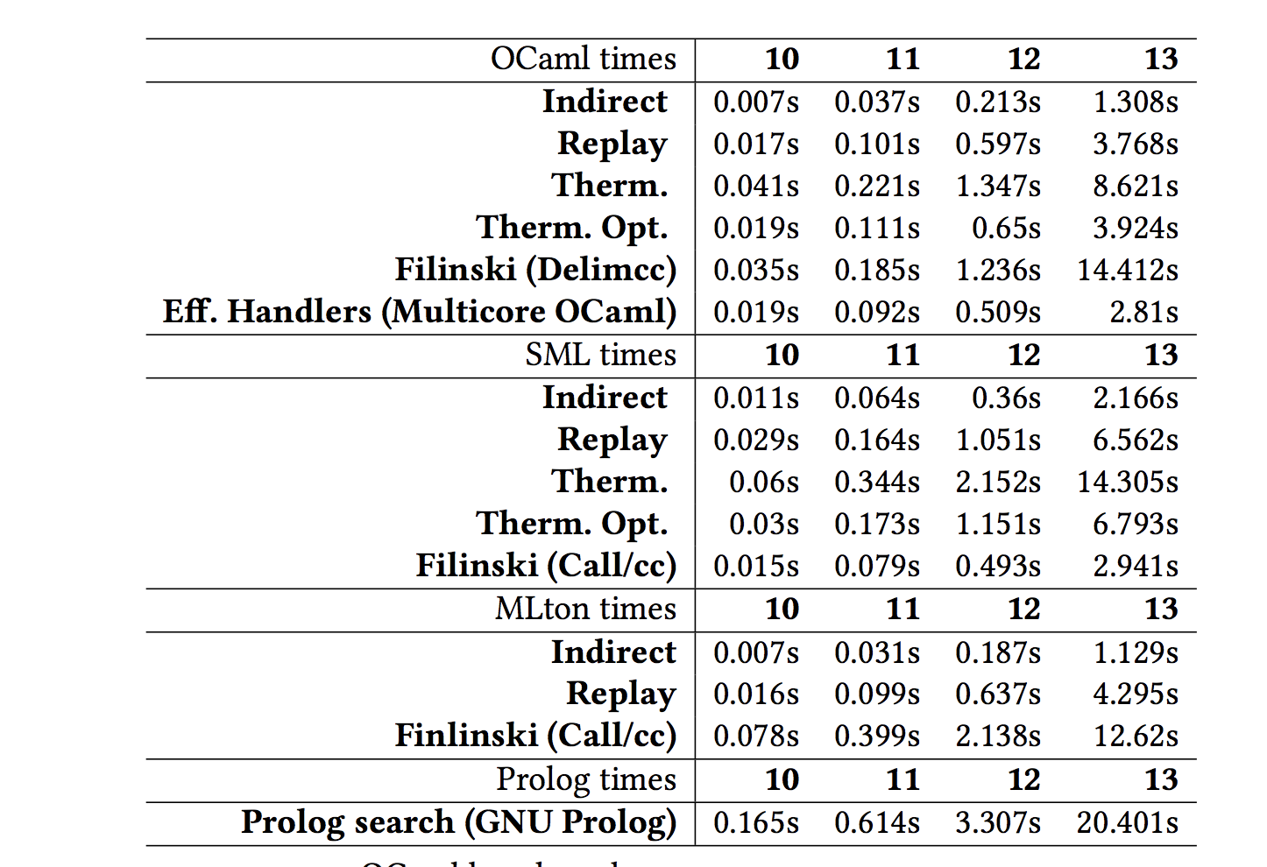
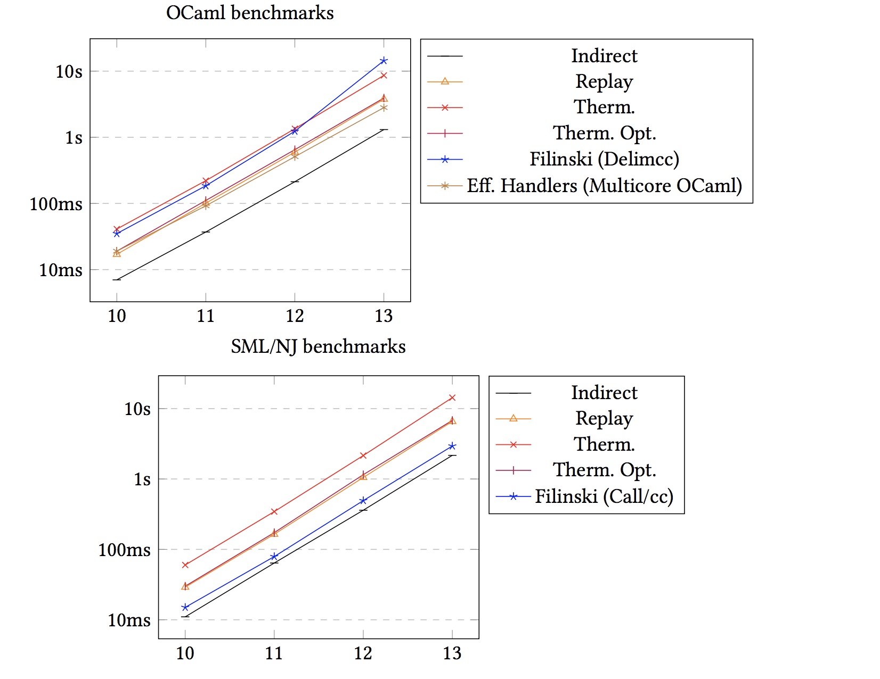
Benchmark: N-queens
n
n
Therm Opt.
0.019
0.111
0.650
3.924
Times (s)
10
11
12
13
Delimcc
0.035
0.185
1.236
14.412
Replay-Based
0.021
0.164
1.051
6.526
Thermometer
0.060
0.344
2.152
14.305
n
Therm Opt.
0.003
0.173
1.151
6.793
10
11
12
13
Times (s)
Replay-
based
0.016
0.099
0.637
4.295
callcc
Times (s)
0.015
0.079
0.493
2.941
callcc
0.078
0.399
2.138
12.620
Indirect
0.011
0.064
0.360
2.166

Slide 39
Plan: Show Replay, then Therm and Therm Opt., then Indirect and callcc .
Then Show Ocaml Delimcc/Therm Opt, and MLTon Replay/Callcc.
Then show Prolog.
Benchmark: N-queens

