Slide 1



Searching Entangled Program Spaces
James Koppel, Zheng Guo, Edsko de Vries,
Armando Solar-Lezama, and Nadia Polikarpova
Notes:
Make zooming in graph more clear.
Explain “top left is good”
The cyclic any node slide was hard to follow, says Armando.

Slide 2
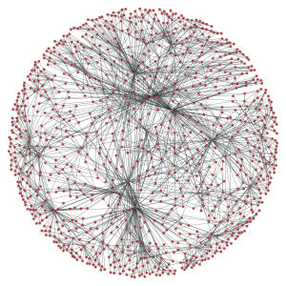
Goal
1. f(x) + f(x)
2. f(y) + f(y)
3. …
constrained
1. compactly represent large term spaces
2. efficiently extract / enumerate terms from the space
Notes:
The goal of compactly representing large term spaces should be familiar to this audience and need not be further motivated. The new thing here is that we are interested in program spaces with more intricate dependencies

Slide 3


Type-driven program synthesis
type
search
programs
τ
1.
2.
3.
library
Notes:
The goal of compactly representing large term spaces should be familiar to this audience and need not be further motivated. The new thing here is that we are interested in program spaces with more intricate dependencies

Slide 4
Type-driven program synthesis
“apply a function n times to an initial value x”
type
search
programs
τ
1.
2.
3.
f:(a → a) → x:a → n:Int → a
(iterate f x) !! n
library

Slide 5
prior work
Hoogle+
SMT-based search
our work
Hectare
ECTA-based search
vs

Slide 6
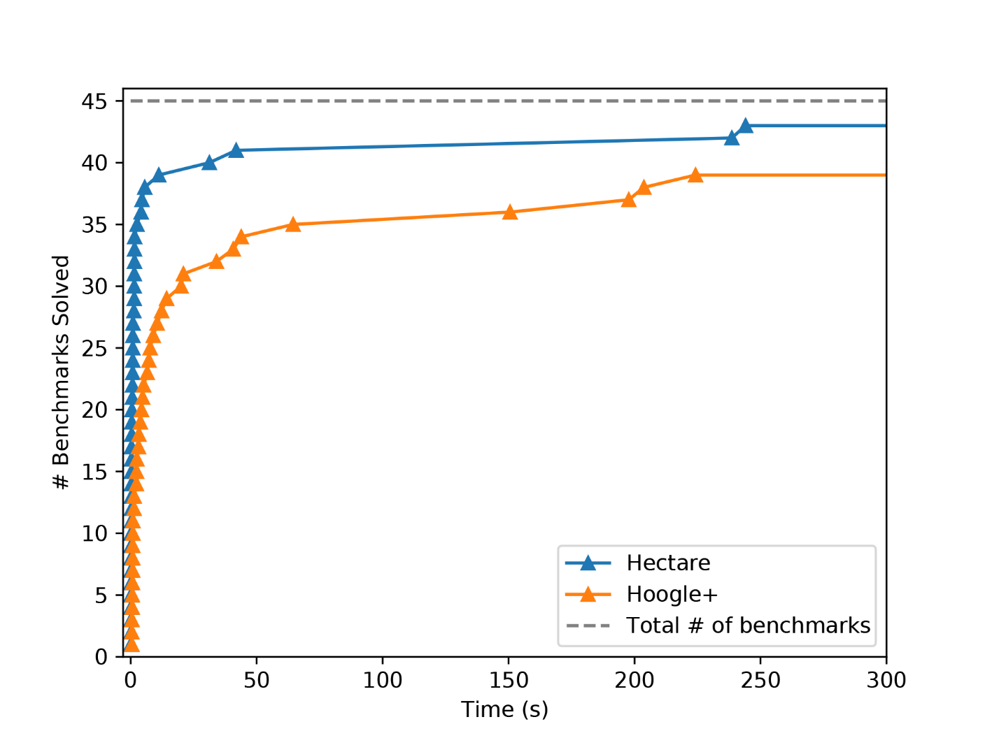
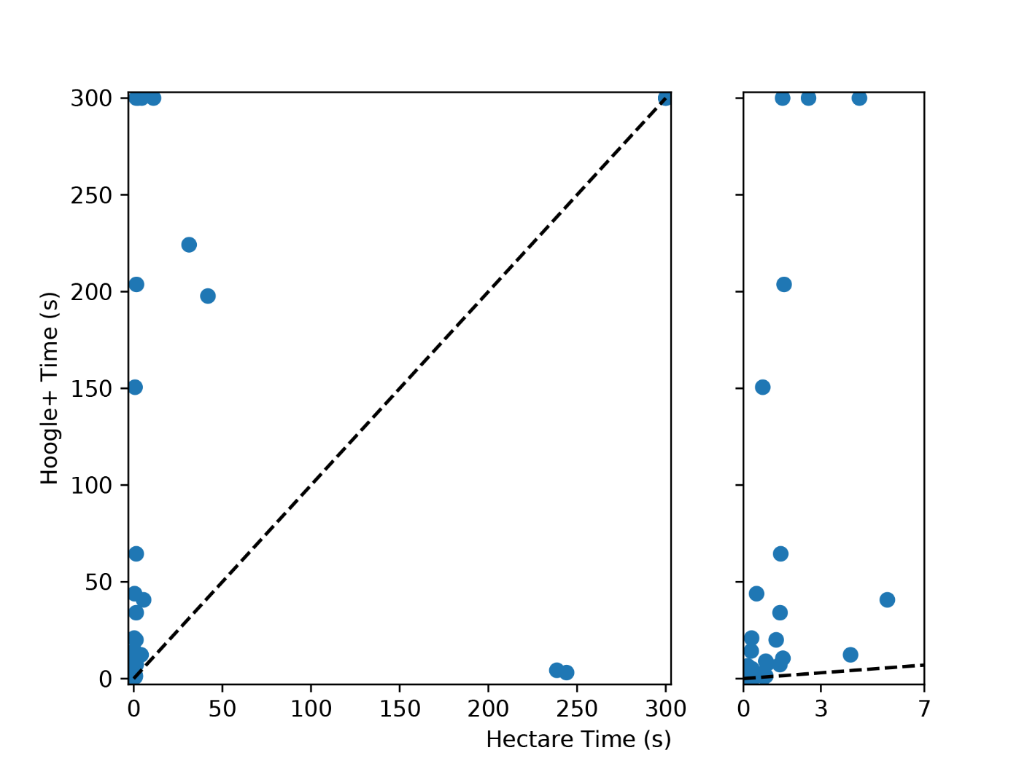
Hoogle+ benchmarks
Hoogle+: Times out
Hectare: Under 3s
8x faster!

Slide 7
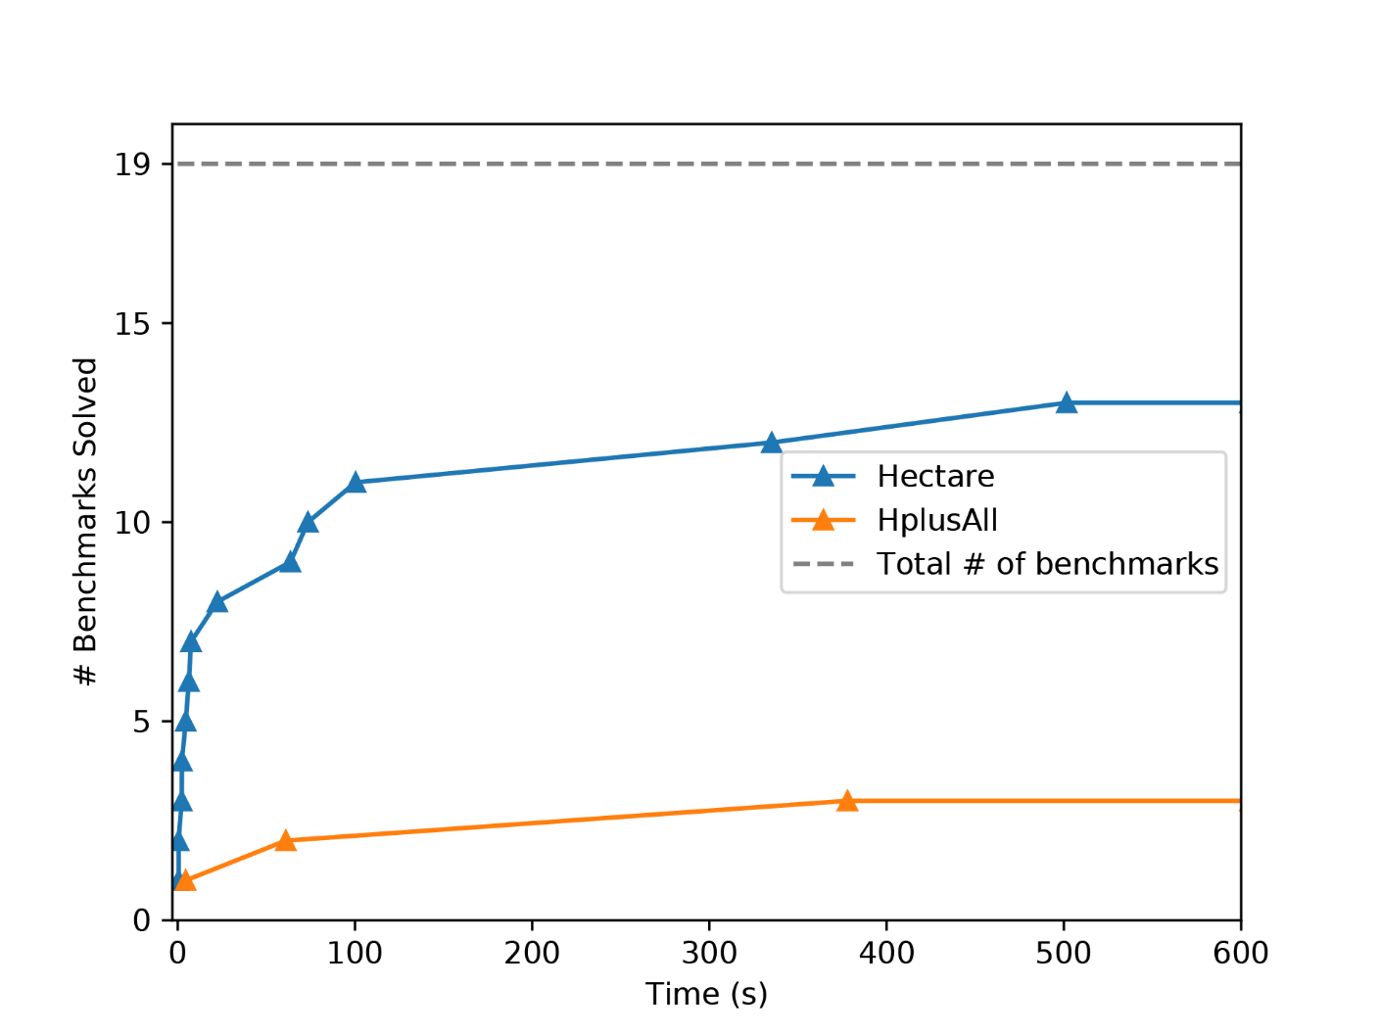
Stackoverflow bechmarks
these benchmarks are larger
and focus on higher-order functions
Hoogle+: 3/19
Hectare: 13/19

Slide 8
Implementation Size
4000 LOC
400 LOC
Hoogle+
Hectare

Slide 9
Equality-
Constrained
Tree
Automata
s
Notes:
serious title

Slide 10
V
So what exactly is an ECTA?
First, what do they do?

Slide 11
V
In the past,
how did we represent
large program spaces?

Slide 12
E-graphs = Compact Program Spaces
Exponentially large
x
y
z
+(x,x)
+(x,y)
+(x,z)
+(y,x)
+(y,y)
+(y,z)
+(z,x)
+(z,y)
+(z,z)
+

Slide 13
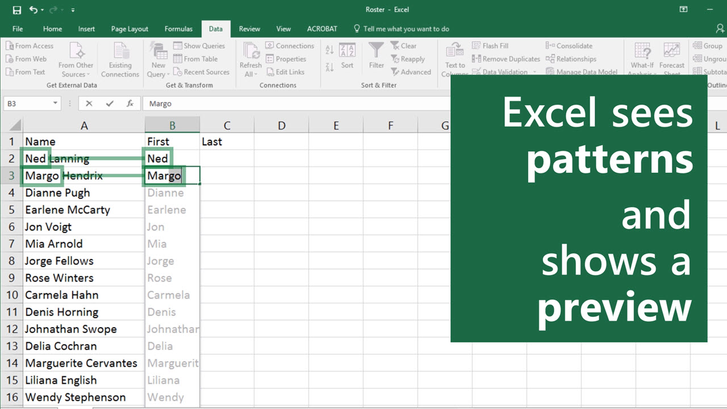
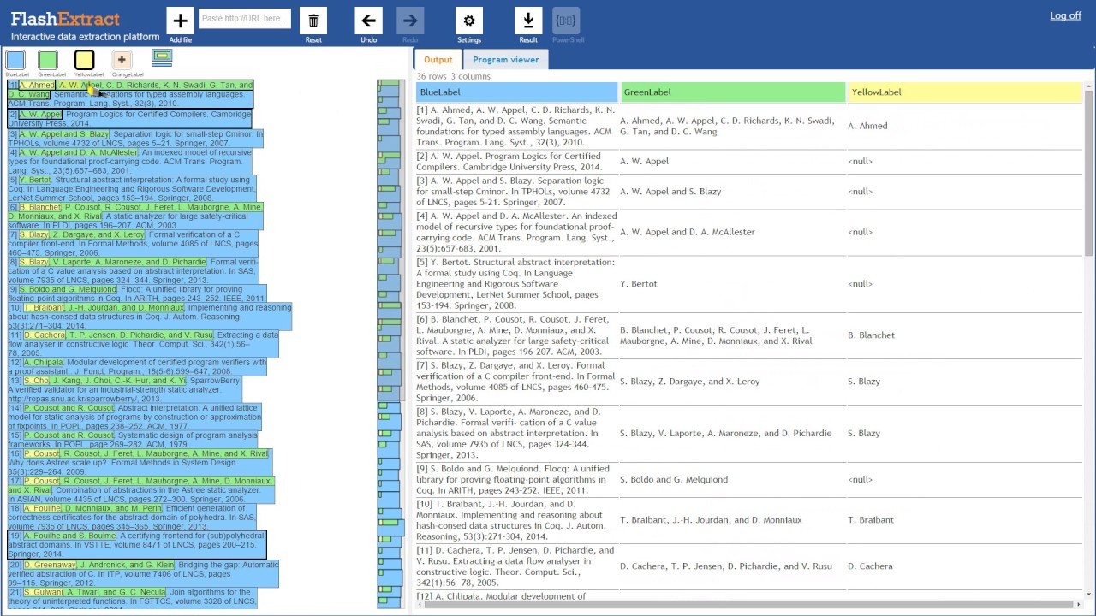
E-graphs = Compact Program Spaces
Exponentially many
Version space algebras
FlashFill
Gulwani, POPL ‘10
FlashExtract
Le and Gulwani, PLDI ‘14
(Used in Excel)
(Used in PowerShell)

Slide 14
E-graphs = Compact Program Spaces
Exponentially large
Repeated variable = “nonlinear pattern”
x
y
z
Consider:
+(A,A) → *(2,A)
Represent matches
+
+(x,x)
+(x,y)
+(x,z)
+(y,x)
+(y,y)
+(y,z)
Includes:
+(x,y)
+(z,x)
+(z,y)
+(z,z)

Slide 15
E-graphs = Compact Program Spaces
Exponentially large
Not So
Repeated variable = “nonlinear pattern”
Consider:
+(A,A) → *(2,A)
x
y
z
Represent matches
+(x,x)
+(x,y)
+(x,z)
+
+
+
+(y,x)
+(y,y)
+(y,z)
+(z,x)
+(z,y)
+(z,z)

Slide 16
V
How can we represent
large program spaces
with
dependent choices?

Slide 17
V
How do we compactly represent
the space of well-typed terms?

Slide 18
level 0: no types
f x
f y
g x
g y
how do we represent this set compactly?
Notes:
We have two unary functions (f and g) and two scalars (x and y), how do we represent all applications of size 1? Let’s rewrite them with explicit application, so that we can better see the common structure

Slide 19
level 0: no types
application
($) f x
($) f y
($) g x
($) g y
how do we represent this set compactly?

Slide 20
level 0: no types
root
t
states
transitions
fun
$
arg
($) f x
($) f y
($) g x
($) g y
unary
scalar
f
g
x
y
a tree automaton!
Notes:
Here a simple tree automaton would do!
For this small set of terms compactness is not obvious, but you can imagine adding more function symbols to our signature.
Tree automata support compact representations using the same mechanisms e-graphs do, by leveraging common top-level structure and subterm sharing (not shown).
States/nodes of a tree automaton are like e-classes and transitions are like e-nodes, but we don’t care if all terms represented by a state are equivalent (it’s just a set of terms).

Slide 21
level 0: no types
t
accepting run
fun
$
arg
($) f x
($) f y
($) g x
($) g y
unary
scalar
f
g
x
y
a tree automaton!
Notes:
To see how this automaton represents, say, the first term, consider its accepting run. In a run, we need to pick one child transition for every state (and all child states of a transition).

Slide 22
level 1: simple types
Γ = { x: Int, y: Char,
f: Int → Bool,
g: Char → Int }
how do we represent
all well-typed size-one applications
compactly?
Notes:
But what if we add types?

Slide 23
our solution: ECTA
step 1: annotate variables with types
t
$
Γ = { x: Int, y: Char,
f: Int → Bool,
g: Char → Int }
fun
arg
unary
scalar
f
g
x
y
targ
tret
targ
tret
type
type
Int
Bool
Char
Notes:
How do we restrict this tree automaton to represent only well-typed terms while still keeping the representation compact?
Here is where our ECTA idea comes in!
Step 1: let’s annotate the variables with their types inside the TA

Slide 24
our solution: ECTA
step 1: annotate variables with types
t
step 2: add an equality constraint
$
fun.targ = arg.type
Γ = { x: Int, y: Char,
f: Int → Bool,
g: Char → Int }
fun
arg
unary
scalar
f
g
x
y
targ
tret
targ
tret
type
type
Int
Bool
Char
Notes:
The main difference between ECTA and regular TAs is that transitions can be annotated with equality constraints that restrict which terms can be chosen at a given path

Slide 25
our solution: ECTA
t
$
fun.targ = arg.type
Γ = { x: Int, y: Char,
f: Int → Bool,
g: Char → Int }
fun
arg
unary
scalar
accepting run
(satisfies constraint)
f
g
x
y
targ
tret
targ
tret
type
type
Int
Bool
Char

Slide 26
our solution: ECTA
t
$
fun.targ = arg.type
Γ = { x: Int, y: Char,
f: Int → Bool,
g: Char → Int }
fun
arg
unary
scalar
not an accepting run
(violates constraint)
f
g
x
y
targ
tret
targ
tret
type
type
Int
Bool
Char

Slide 27
level 2: basic polymorphism
Γ = { x: Int, y: Char,
f: Int → Bool,
g: Char → Int,
h: ∀a . a → a
}
what if functions can be polymorphic?
Notes:
What if we introduce polymorphism and make g: a -> a? (for now a can only be a primitive type).
Look, ECTAs can represent variables (here type variables) without any binders! (Show bottom of Fig 4, no query).

Slide 28
level 2: basic polymorphism
step 1: type variable = set of instances
t
step 2: add an equality constraint
$
fun.targ = arg.type
Γ = { x: Int, y: Char,
f: Int → Bool,
g: Char → Int,
h: ∀a . a → a
}
fun
arg
unary
scalar
targ = tret
h
f
g
x
y
targ
tret
type
type
any
Int
Bool
Char
Notes:
What if we introduce polymorphism and make g: a -> a? (for now a can only be a primitive type).
Look, ECTAs can represent variables (here type variables) without any binders! (Show bottom of Fig 4, no query).

Slide 29
level 3: higher-order language
step 1: represent all types
with a cyclic ECTA
var
x
map
any
type
type
List
→
Int
→
in
Int
Bool
step 2: represent all variables uniformly
→
in
out
any
map: ∀a,b . (a → b) → List a → List b

Slide 30
level 3: higher-order language
step 1: represent all types
with a cyclic ECTA
var
x
map
in.in=out.in.elem
in.out=out.out.elem
any
any
type
type
→
Int
List
→
→
List
in
out
Int
Int
Bool
Bool
step 2: represent all variables uniformly
→
→
in
out
in
out
any
List
elem
map: ∀a,b . (a → b) → List a → List b

Slide 31
V
Synthesis
=
ECTA enumeration

Slide 32
enumerating terms
t
how do we enumerate terms accepted by this ECTA?
fun.targ = arg.type
$
fun
arg
unary
scalar
h
f
g
x
y
targ = tret
targ
tret
type
type
any
Γ = { x: Int, y: Char,
f: Int → Bool,
g: Char → Int,
h: ∀a . a → a
}
Int
Bool
Char

Slide 33

enumerating terms
t
how do we enumerate terms accepted by this ECTA?
fun.targ = arg.type
$
fun
arg
unary
scalar
($) (h :: Int → Bool) x
h
f
g
x
y
targ = tret
targ = tret
targ
tret
type
type
any
Γ = { x: Int, y: Char,
f: Int → Bool,
g: Char → Int,
h: ∀a . a → a
}
Int
Bool
Char

Slide 34
enumerating terms
t
how do we enumerate terms accepted by this ECTA?
fun.targ = arg.type
fun.targ = arg.type
$
fun
arg
unary
scalar
($) (h :: Int → Bool) x
($) (h :: Bool → Bool) x
h
f
g
x
y
targ = tret
targ
tret
type
type
any
Γ = { x: Int, y: Char,
f: Int → Bool,
g: Char → Int,
h: ∀a . a → a
}
Int
Bool
Char

Slide 35

enumerating terms
t
efficiently
how do we enumerate terms accepted by this ECTA?
fun.targ = arg.type
$
fun
arg
unary
scalar
($) (h :: Int → Bool) x
($) (h :: Bool → Bool) x
h
f
g
x
y
targ = tret
($) (h :: Int → Int) x
targ
tret
type
type
any
only 4/22 runs
satisfy constraints
Γ = { x: Int, y: Char,
f: Int → Bool,
g: Char → Int,
h: ∀a . a → a
}
Int
Bool
Char

Slide 36
fast enumeration
t
idea: resolve constrained
states lazily
fun.targ = arg.type
$
fun
arg
unary
scalar
h
f
g
x
y
targ = tret
targ
tret
type
type
any
Γ = { x: Int, y: Char,
f: Int → Bool,
g: Char → Int,
h: ∀a . a → a
}
Int
Bool
Char

Slide 37
fast enumeration
t
fun.targ = arg.type
$
fun
arg
propagate constraint down
targ = v₁
type = v₁
unary
scalar
h
f
g
x
y
targ = tret
targ
tret
type
type
any
Γ = { x: Int, y: Char,
f: Int → Bool,
g: Char → Int,
h: ∀a . a → a
}
Int
Bool
Char

Slide 38
fast enumeration
t
t
$
unary
scalar
$
h
x
y
arg
any
t
fun
type = v₁
targ = v₁
Int
Bool
Char
unary
scalar
$
unary
scalar
f
x
y
h
f
g
x
y
targ = tret
targ
tret
type
type
t
Int
Bool
Char
any
$
unary
scalar
Int
Bool
Char
g
x
y
Int
Char

Slide 39
fast enumeration
t
$
fun
arg
targ = v₁
type = v₁
unary
scalar
h
f
g
x
y
targ = tret
targ
tret
type
type
any
Γ = { x: Int, y: Char,
f: Int → Bool,
g: Char → Int,
h: ∀a . a → a
}
Int
Bool
Char

Slide 40
fast enumeration
t
constrained state:
suspend!
$
fun
arg
unary
type = v₁
scalar
targ = tret
= v₁
h
x
y
targ
tret
type
type
ε = v₁
a₁
a₂
ε = v₁
Γ = { x: Int, y: Char,
f: Int → Bool,
g: Char → Int,
h: ∀a . a → a
}
Int
Bool
Char

Slide 41
fast enumeration
v₁:
t
a₁
$
Int
Bool
Char
fun
arg
unary
type = v₁
scalar
h
x
y
targ
tret
type
type
v₁
a₂
ε = v₁
v₁ already initialized:
intersect a₁ and a₂!
Γ = { x: Int, y: Char,
f: Int → Bool,
g: Char → Int,
h: ∀a . a → a
}
Int
Bool
Char

Slide 42
fast enumeration
v₁:
t
a₁
$
Int
Bool
Char
fun
arg
unary
type = v₁
scalar
h
x
y
targ
tret
type
type
v₁
v₁
Γ = { x: Int, y: Char,
f: Int → Bool,
g: Char → Int,
h: ∀a . a → a
}
Int
Char

Slide 43
fast enumeration
v₁:
t
a₁
$
Int
Bool
Char
fun
arg
unary
type = v₁
scalar
h
x
y
targ
tret
type
type
v₁
v₁
ε = v₁
Γ = { x: Int, y: Char,
f: Int → Bool,
g: Char → Int,
h: ∀a . a → a
}
Int
Char

Slide 44
fast enumeration
v₁:
t
a₁
$
Int
Bool
Char
fun
arg
unary
scalar
h
x
targ
tret
type
v₁
v₁
ε = v₁
tx
intersect a₁ and tx!
Γ = { x: Int, y: Char,
f: Int → Bool,
g: Char → Int,
h: ∀a . a → a
}
Int

Slide 45
fast enumeration
v₁:
t
a₁
$
Int
fun
arg
unary
scalar
found solution
without backtracking!
h
x
($) (h :: Int → Int) x
targ
tret
type
v₁
v₁
v₁
Γ = { x: Int, y: Char,
f: Int → Bool,
g: Char → Int,
h: ∀a . a → a
}

Slide 46
fast enumeration
t
fun.targ = arg.type
$
fun
arg
propagate constraint down
targ = v₁
type = v₁
unary
scalar
h
f
g
x
y
targ = tret
targ
tret
type
type
any
Γ = { x: Int, y: Char,
f: Int → Bool,
g: Char → Int,
h: ∀a . a → a
}
Int
Bool
Char

Slide 47
fast enumeration
t
t
$
unary
scalar
$
h
x
y
arg
any
t
fun
type = v₁
targ = v₁
Int
Bool
Char
unary
scalar
$
unary
scalar
f
x
y
h
f
g
x
y
targ = tret
targ
tret
type
type
t
Int
Bool
Char
any
$
unary
scalar
Int
Bool
Char
g
x
y
Int
Char

Slide 48
fast enumeration
t
$
fun
arg
targ = v₁
type = v₁
unary
scalar
h
f
g
x
y
targ = tret
targ
tret
type
type
any
Γ = { x: Int, y: Char,
f: Int → Bool,
g: Char → Int,
h: ∀a . a → a
}
Int
Bool
Char

Slide 49
fast enumeration
t
$
fun
arg
targ = v₁
type = v₁
unary
scalar
h
f
g
x
y
targ = tret
targ
tret
type
type
any
Γ = { x: Int, y: Char,
f: Int → Bool,
g: Char → Int,
h: ∀a . a → a
}
Int
Bool
Char

Slide 50
fast enumeration
t
$
fun
arg
targ = v₁
type = v₁
unary
scalar
f
x
y
targ
tret
type
type
Γ = { x: Int, y: Char,
f: Int → Bool,
g: Char → Int,
h: ∀a . a → a
}
Int
Bool
Char

Slide 51
fast enumeration
v₁:
t
a₁
$
Int
fun
arg
targ = v₁
type = v₁
unary
scalar
f
x
y
targ
tret
v₁
type
type
Γ = { x: Int, y: Char,
f: Int → Bool,
g: Char → Int,
h: ∀a . a → a
}
Int
Bool
Char

Slide 52
fast enumeration
v₁:
t
a₁
$
Int
fun
arg
targ = v₁
type = v₁
unary
scalar
f
x
y
targ
tret
v₁
type
type
Γ = { x: Int, y: Char,
f: Int → Bool,
g: Char → Int,
h: ∀a . a → a
}
Int
Bool
Char

Slide 53
fast enumeration
v₁:
t
a₁
$
Int
fun
arg
targ = v₁
type = v₁
unary
scalar
f
x
y
targ
tret
v₁
type
type
Γ = { x: Int, y: Char,
f: Int → Bool,
g: Char → Int,
h: ∀a . a → a
}
Int
Bool
Char

Slide 54
fast enumeration
v₁:
t
a₁
$
Int
fun
arg
targ = v₁
type = v₁
unary
scalar
found 2nd solution
without backtracking!
($) (f :: Int → Bool) x
f
x
targ
tret
v₁
type
Γ = { x: Int, y: Char,
f: Int → Bool,
g: Char → Int,
h: ∀a . a → a
}
Int
Bool

Slide 55
Hoogle+ benchmarks
Hoogle+: Times out
Hectare: Under 3s
8x faster!

Slide 56
Implementation Size
4000 LOC
400 LOC
Hoogle+
Hectare

Slide 57

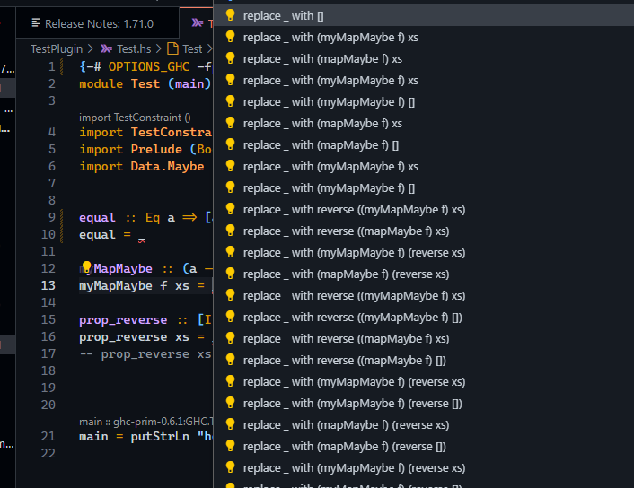
Hectare GHC Plugin
Matthias Gissurarson
Chalmers University of Technology

Slide 58
V
More Encodings,
More Applications

Slide 59
SAT
(also in the paper)

Slide 60
Binders
(future work)
(λx ⟶ x : x : x : []) 1
(λx ⟶ x : x : x : []) 2

Slide 61
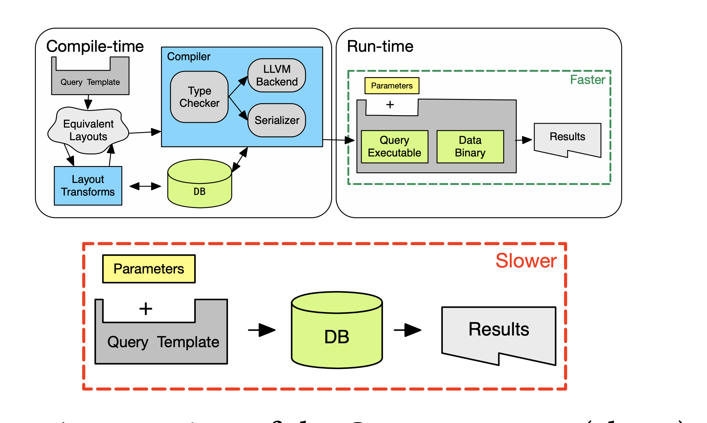
Application: Database Synthesis

Slide 62
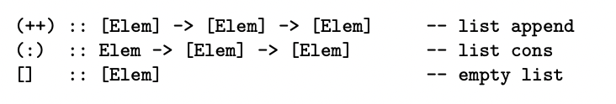

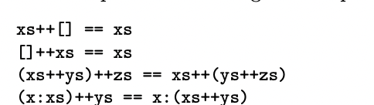
Spectacular: Finding Laws from 25 Trillion Programs
(in submission)
Matthias Gissurarson
Chalmers University of Technology
Diego Alonso Roque Montoya
Dark Forest Technologies / MIT Alum

Slide 63
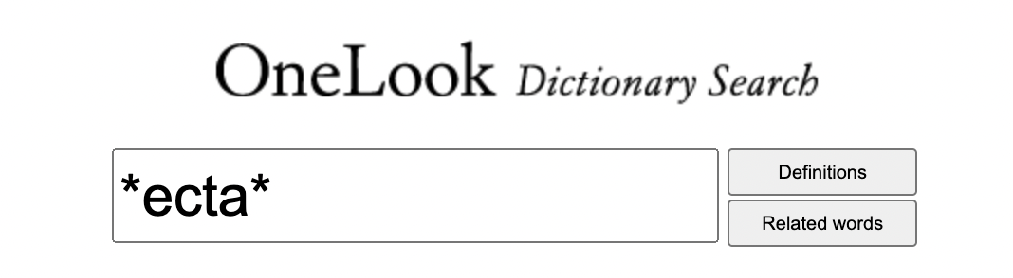
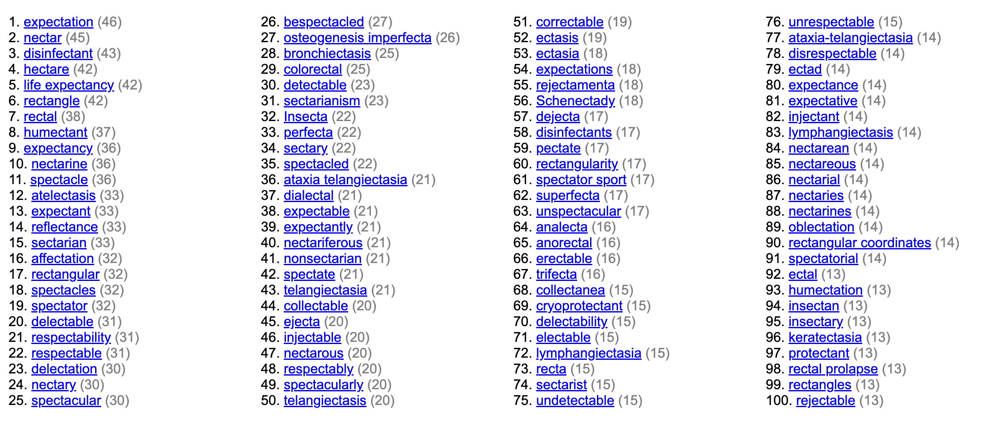


And more!

Slide 64
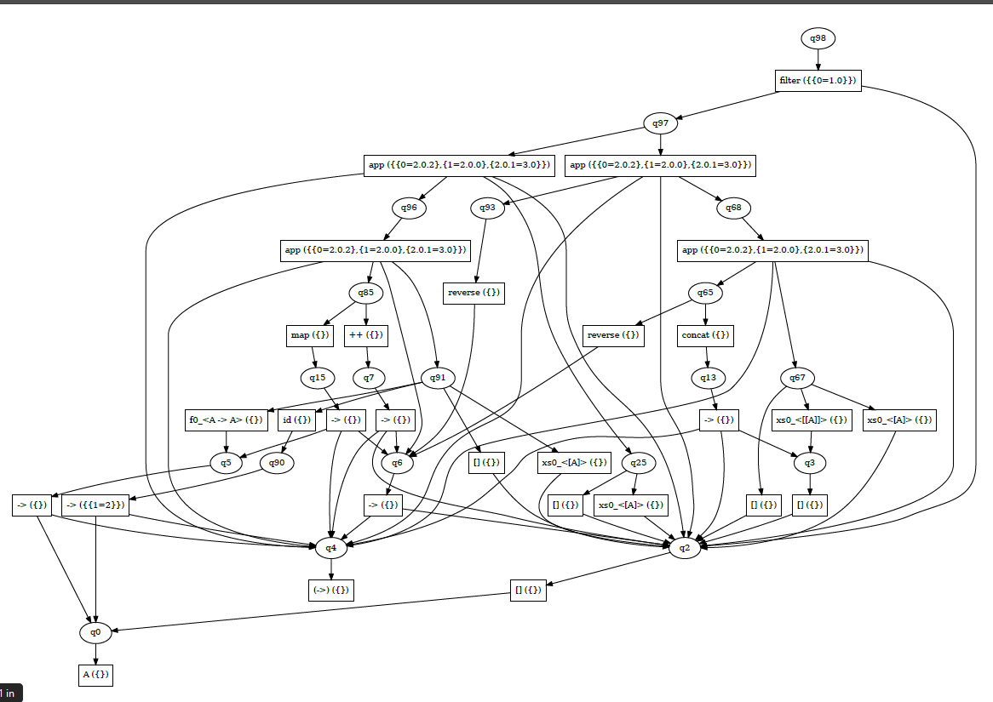
Equality-
Constrained
Tree
Automata
s
var
x
map
in.in=out.in.elem
in.out=out.out.elem
any
type
type
List
→
Int
→
in
out
Int
Bool
→
→
in
out
in
out
any
List
elem
Notes:
serious title

Slide 65
Bonus: More on Binders
Binders in e-graphs: Explicit substitutions (main encoding)
In ECTA: Native support for reverse de Bruijn
(λx ⟶ x : x : x : []) 1
(λx ⟶ x : x : x : []) 2
Accepting terms:
instantiate(1, abstract(1, 1:1:1:[]))
instantiate(2, abstract(2, 2:2:2:[]))
E-graphs cannot share the representation of anti-unifiable terms.
But ECTAs can.

