Slide 1

Demystifying Dependence
Jimmy Koppel
Daniel Jackson
Notes:
Michigan report: : Cyrus said it was pretty good. I had 90 minutes and went 77 minutes. 35 minutes for Cubix. Lots of places it can be tightened up. I think I need to cut the Cubix section a lot; add deeper stuff to Yogo section; remove some details from Mandate section. I felt like I was talking too fast, and it still felt like 3 talks glued together.
Armando onProgrammer’s Apprentice slide: Say “Our system lets you do this, and people have been trying to do this since….” Make sure to say it in a way that it doesn’t sound like you want people to have already heard of the Programmer’s Apprentice.
Thoughts on Yogo section: Improve formatting of intro slides, tease at a fancier query, add a quick slide about loops, add a slide about the idea of the Programmer’s Apprentice independent of Yogo, thin evaluation section and add Oracle,
Mandate section: Make it more about reuse. Also, maybe change abstraction slide to just show the code of value irrelevance. For the preview slide, blur the graph code.
To make it less like three talks strung together:
Present Yogo less as its own thing, more like something built on Cubix
Transition from Cubix to Mandate: Say “We’ve talked about reusing code between tools for different languages; now I want to talk about a different kind of reuse, if you want multiple tools for the same language.”

Slide 2
A core pillar of software design is controlling dependencies
OS Stability
Rocket Safety
Application
Stability
Unused Component

Slide 3

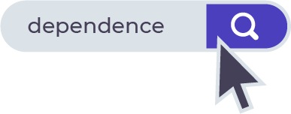
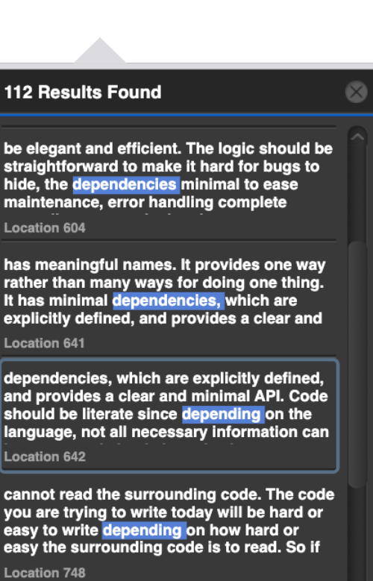


Slide 4
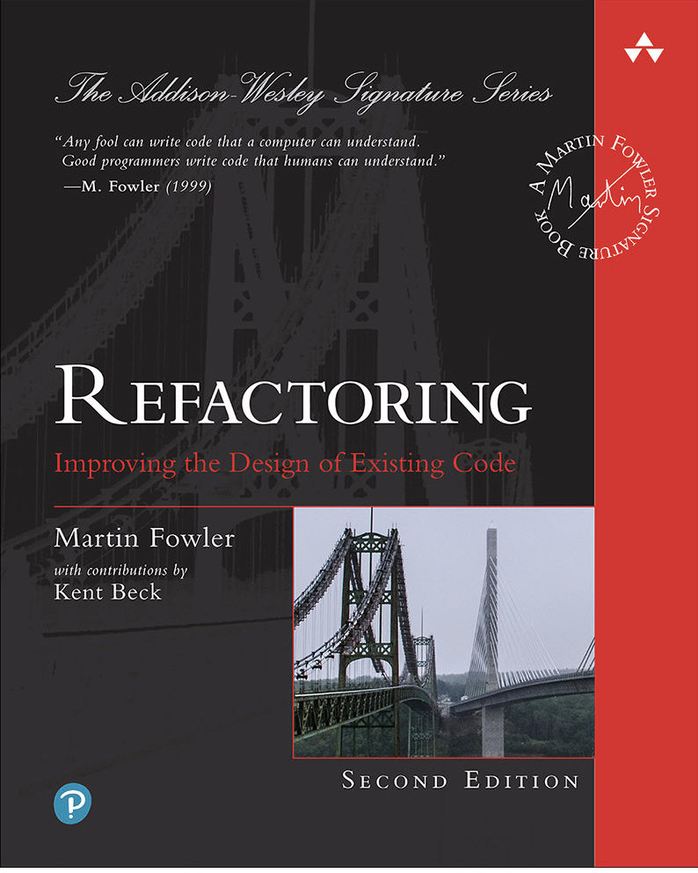
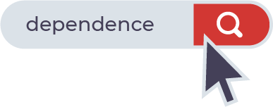
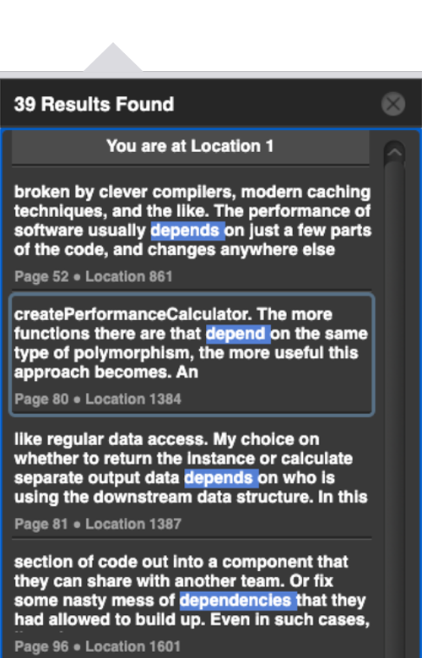


Slide 5

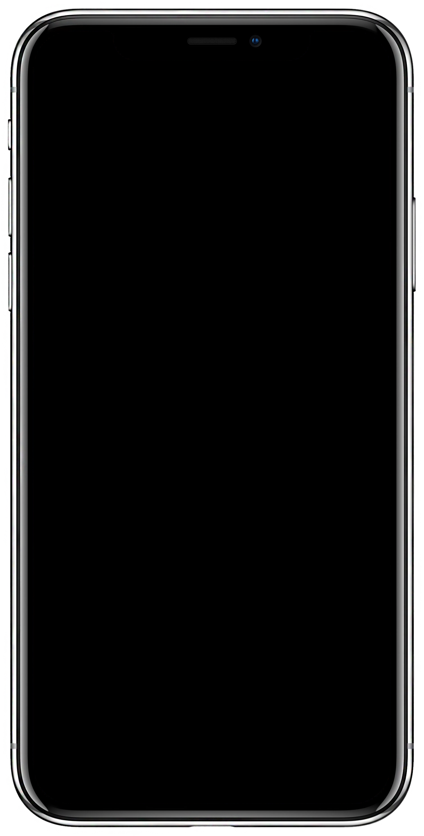

A “Simple” Question
Notes:
Mockup is from https://vizualus.com/shop/free-iphone-x-slide/ . Distributed for free; no visible license.

Slide 6
A “Simple” Question
Analytics
Abstraction
Layer
Does the app depend on the analytics framework?
Notes:
Mockup is from https://vizualus.com/shop/free-iphone-x-slide/ . Distributed for free; no visible license.

Slide 7
“I can remove this dependency by placing a simple delegating method on the server that hides the delegate.”
— Martin Fowler
Interposed
delegator
Analytics
Abstraction
“If something logical depends on the implementation, then something physical should too.”
— Robert Martin
Implication:
Interposing the analytics abstraction layer removes a dependence, and this is bad?
Notes:
Quora source: https://www.quora.com/Software-Engineering-Best-Practices-What-is-the-difference-between-coupling-and-dependency
Give patter about “AbstractDelegateFactory” removing physical stuff.

Slide 9
The Nine Dependency Puzzles
Framework
Shared Format
Majority
9
Frame
Dependency Puzzles
Higher-Order
Crash
Self-Cycle
Indirection
Fallback
Notes:
Clipart origins:
http://clipart-library.com/clipart/n67533.htm
Personal use license

Slide 10
Framework
Shared Format
Majority
If A calls B: Then A depends on B
A round-robin scheduler invokes many tasks
Does the scheduler depend on each of the tasks?
Frame
Higher-Order
A
Crash
Self-Cycle
B
B
B
B
Indirection
Fallback
Notes:
Clipart origins:
http://clipart-library.com/clipart/n67533.htm
Personal use license

Slide 11
Framework
Shared Format
Majority
A does not depend on B if a change to B cannot break A.
B can be changed to make the whole program crash.
So, does every module depend on every other module?
Frame
Higher-Order
Crash
Self-Cycle
B
A
Indirection
Fallback
Notes:
Clipart origins:
http://clipart-library.com/clipart/n67533.htm
Personal use license

Slide 12
Framework
Shared Format
Majority
Module A processes payments using Payment Processor B.
If Processor B fails, the module tries Processor C instead, which is more expensive but always succeeds.
Does the module depend on Processor B?
Frame
Higher-Order
Crash
B
⇒
C
Self-Cycle
A
Indirection
Fallback
Notes:
Clipart origins:
http://clipart-library.com/clipart/n67533.htm
Personal use license

Slide 13
Many Answers
Does the app depend on the analytics framework?
“No. It can be built and shipped totally separately.”
“Yes. Any time Google Analytics fails or crashes,
the app may too.”
“No. You can swap it out for a different framework
with no change in app code.”
“Yes. Improvements to the framework’s accuracy
will help the app.”
“Yes. Any vulnerability in the framework is a
vulnerability for the app.”
Analytics
Abstraction
These Answer
Different
Questions!
Notes:
Mockup is from https://vizualus.com/shop/free-iphone-x-slide/ . Distributed for free; no visible license.

Slide 14

Factors of Dependence
Semantics
Dependence
Properties
Permitted Changes

Slide 15
Semantics
Dependence
Properties
Permitted Changes

Slide 16
“The moment you
import a new package into your project,
it becomes a ‘dependency,’
yet the project does not ‘depend’ on it until it's used.
If the dependency in question is Google Analytics, but the app would work with Mixpanel without any changes, then the code ‘does not depend’ on Google Analytics.”
These are all different models

Slide 17
Factor: Choice of Semantics
Static Semantics
Dynamic Semantics
𝚪 ⊢ e : 𝛕
e ⇝ e′
Build dependencies
Runtime behavior dependencies
Program Logic / Proof Semantics
{ P } S { Q }
Functional Requirements

Slide 18
Factor: Choice of Semantics
“No. It can be built and shipped totally separately.”
“Yes. Any time Google Analytics fails or crashes,
the app may too.”
“No. You can swap it out for a different framework
with no change in app code.”
“Yes. Improvements to the framework’s accuracy
will help the app.”
“Yes. Any vulnerability in the framework is a
vulnerability for the app.”
Static Semantics
Dynamic Semantics
Program Logic
Also Program Logic
Notes:
Mockup is from https://vizualus.com/shop/free-iphone-x-slide/ . Distributed for free; no visible license.

Slide 19
Factors of Dependence
Semantics
Dependence
Properties
Permitted Changes

Slide 20
Semantics
Dependence
Properties
Permitted Changes

Slide 21
Factor: Properties
A
DON’T ASK:
“Does A depend on B?”
B
𝞅( )
A
ASK:
“Does property 𝞅 of A depend on B?”
B

Slide 22
Factor: Properties
Does the app depend
on the analytics framework?
Question
Property
Depends?
Well-formedness
“No. It can be built and shipped totally separately.”
“Yes. Any time Google Analytics fails or crashes,
the app may too.”
“No. You can swap it out for a different framework
with no change in app code.”
“Yes. Improvements to the framework’s accuracy
will help the app.”
“Yes. Any vulnerability in the framework is a
vulnerability for the app.”
X
(with certain assumptioans about linking)
Runtime behavior
Correctness
X
Statistical performance
Security
…so maybe correctness does depend?
Notes:
Mockup is from https://vizualus.com/shop/free-iphone-x-slide/ . Distributed for free; no visible license.

Slide 23
Framework
The Nine Dependency Puzzles
Shared Format
If A calls B: Then A depends on B
A round-robin scheduler invokes many tasks
Does the scheduler depend on each of the tasks?
Majority
Many runtime properties: Yes
Frame
Higher-Order
Correctness: No
A
…unless a task doesn’t terminate.
Crash
Self-Cycle
This actually happens!
Fallback
Indirection
If have extra time on this slide, can make next slide about java.util.Timer.

Slide 24
Semantics
Dependence
Properties
Permitted Changes

Slide 25
Semantics
Dependence
Properties
Permitted Changes

Slide 26
But consider an attacker
Dependence, Operationally
Those changes don’t count
If A does not depend on B,
then no change to B can affect A
*
†
… unless that change introduces a dependence?
* Unless the change introduces a dependence, say by modifying a global variable
† Not including changes that crash the program
Notes:
Security guard: From http://clipart-library.com/clipart/1947313.htm . Licensed for personal use only
https://www.freepik.com/free-vector/job-interview-conversation_9650007.htm#page=1&query=man%20computer&position=1
attribute pch.vector
<a href='https://www.freepik.com/vectors/computer'>Computer vector created by pch.vector - www.freepik.com</a>

Slide 27
Unrestricted Changes = Chaos
analytics.init();
analytics.recordAppOpen();
analytics.recordUserLoggedIn();
/*
* Precondition: Analytics is initted
* Postcondition: AppOpen event recorded
*/
public void recordAppOpen() {
...
}
Depends?
Is there any change to the postcondition that affects the property?
Property: UserLoggedInEvent has been recorded.
OF COURSE THERE IS

Slide 28
Unrestricted Changes = Chaos
analytics.init();
analytics.recordAppOpen();
analytics.recordUserLoggedIn();
/*
* Precondition: Analytics is initted
* Postcondition: AppOpen event recorded
*/
public void recordAppOpen() {
...
}
and analytics is un-initted
Depends?
Is there any change to the postcondition that affects the property?
Property: UserLoggedInEvent has been recorded.
OF COURSE THERE IS

Slide 29
Super-spec:
A constraint on permitted changes
(to a spec, trace, etc)

Slide 30
Restricted Changes = Clarity
analytics.init();
analytics.recordAppOpen();
analytics.recordUserLoggedIn();
/*
* Precondition: Analytics is initted
* Postcondition: AppOpen event recorded
* Superspec: Init status unaffected
*/
public void recordAppOpen() {
...
}
Depends?
Property: UserLoggedInEvent has been recorded.
NO!

Slide 31
Framework
The Nine Dependency Puzzles
Shared Format
Majority
If A calls B: Then A depends on B
A round-robin scheduler invokes many tasks
Does the scheduler depend on
each of the tasks?
Many runtime properties: Yes
Frame
Higher-Order
Correctness: No
…unless a task doesn’t terminate.
A
Crash
Self-Cycle
Fallback
Indirection
If have extra time on this slide, can make next slide about java.util.Timer.

Slide 32
Framework
The Nine Dependency Puzzles
Shared Format
Majority
A does not depend on B if no change to B can break A.
B can be changed to make the whole program crash.
So, does every module depend on every other module?
Frame
Higher-Order
Only if crashing changes
are permitted!
Crash
Self-Cycle
B
A
Fallback
Indirection
Notes:
Clipart origins:
http://clipart-library.com/clipart/n67533.htm
Personal use license

Slide 33
Framework
The Nine Dependency Puzzles
Shared Format
Majority
Module A processes payments using Payment Processor B.
If Processor B fails, the module tries Processor C instead, which is more expensive but always succeeds.
Does the module depend on Processor B?
Frame
Higher-Order
?
Crash
B
⇒
C
Self-Cycle
A
Fallback
Indirection
Notes:
Clipart origins:
http://clipart-library.com/clipart/n67533.htm
Personal use license

Slide 34
A Fallback Example
Try: Send data to USA server
If fail: Send data to EU server
Notes:
Server clipart from https://publicdomainvectors.org/en/free-clipart/Graphic-server-vector-drawing/26789.html . Public domain.

Slide 35
A Fallback Example
Try: Send data to USA server
If fail: Send data to EU server
Actual run: It did send data to the US server.
Did its success depend on the US server?
Notes:
Server clipart from https://publicdomainvectors.org/en/free-clipart/Graphic-server-vector-drawing/26789.html . Public domain.

Slide 36


Rain
”If no rain,
turn on sprinkler.”
“If US server fails,
try EU.”
Sprinkler
=
=
=
Wet Grass
Sending data succeeded
Sending data succeeded

Slide 37
Semantics
Dependence
=
Properties
Causation
Permitted Changes

Slide 38
Ingredients
Semantics
Dependence
=
Causation
Choose some kind of execution model (semantics)
Check whether some property holds….
after making some permitted changes
Properties
Peramitted Changes
= Counterfactual execution

Slide 39
All of our examples are isomorphic to causality in the physical world!
Dependence
Causality
Round-robin scheduler depends on tasks?
B can crash ⇒ everything depends on B
Is ability to stack boxes caused
by box contents?
You having dinner is caused by my actions
(not cutting your electricity)
If no rain, turn on sprinkler
Use C if B fails ⇒ no dependence on B?

Slide 40
Actual
Causality

Slide 41
Rain
A Causal Graph
Sprinkler
bool rain = true;
bool sprinkler = !rain;
bool grass_wet = rain || sprinkler;
Wet Grass
Notes:
Sources:
https://www.pexels.com/photo/landscape-photography-of-green-grass-field-2684805/
https://www.pexels.com/photo/person-in-black-hoodie-riding-swing-while-raining-804474/
https://www.pexels.com/photo/green-grassy-lawn-in-cold-dew-4406352/

Slide 42
Rain
A Causal Graph
Did the rain cause the grass to be wet?
Yes…because if it didn’t rain, the grass would not be wet?
Sprinkler
true
bool rain = true;
bool sprinkler = !rain;
bool grass_wet = rain || sprinkler;
false
true
Wet Grass
Notes:
Sources:
https://www.pexels.com/photo/landscape-photography-of-green-grass-field-2684805/
https://www.pexels.com/photo/person-in-black-hoodie-riding-swing-while-raining-804474/
https://www.pexels.com/photo/green-grassy-lawn-in-cold-dew-4406352/
NEW
https://www.pexels.com/photo/beautiful-clean-close-up-dew-347925/
https://www.pexels.com/photo/selective-focus-photo-of-obalte-green-leafed-plants-during-rain-1463530/

Slide 43
Rain
A Causal Graph
Did the rain cause the grass to be wet?
Yes…because if it didn’t rain, the grass would not be wet?
Sprinkler
false
bool rain = true;
bool sprinkler = !rain;
bool grass_wet = rain || sprinkler;
true
true
Wet Grass
Notes:
Sources:
https://www.pexels.com/photo/landscape-photography-of-green-grass-field-2684805/
https://www.pexels.com/photo/person-in-black-hoodie-riding-swing-while-raining-804474/
https://www.pexels.com/photo/green-grassy-lawn-in-cold-dew-4406352/

Slide 44
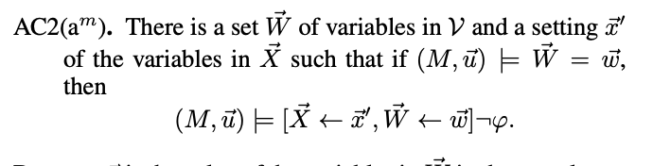
Rain
A Causal Graph
Did the rain cause the grass to be wet?
Yes…because if it didn’t rain, the grass would not be wet?
Sprinkler
Bad definition: A is an actual cause of B if,
had something else happened, B would
not have happened.
&
Better definition (Halpern 2015):
A is an actual cause of B if,
had a particular different thing happened,
and some events counterfactually stayed the same,
B would not have happened.
Wet Grass
Notes:
Sources:
https://www.pexels.com/photo/landscape-photography-of-green-grass-field-2684805/
https://www.pexels.com/photo/person-in-black-hoodie-riding-swing-while-raining-804474/
https://www.pexels.com/photo/green-grassy-lawn-in-cold-dew-4406352/

Slide 45
Rain
A Causal Graph
false
bool rain = true;
bool sprinkler = !rain;
bool grass_wet = rain || sprinkler;
Sprinkler
false
forced to same as original run
false!
Better definition (Halpern 2015):
A is an actual cause of B if,
had a particular different thing happened,
and some events counterfactually stayed the same,
B would not have happened.
Turn rain off,
Keep sprinkler off,
Grass is not wet.
Therefore, the rain
caused the grass’s
wetness
Wet Grass
Notes:
Sources:
https://www.pexels.com/photo/landscape-photography-of-green-grass-field-2684805/
https://www.pexels.com/photo/person-in-black-hoodie-riding-swing-while-raining-804474/
https://www.pexels.com/photo/green-grassy-lawn-in-cold-dew-4406352/

Slide 46
Rain
”If no rain,
turn on sprinkler.”
“If US server fails,
try EU.”
Sprinkler
=
=
=
Turn rain off,
Keep sprinkler off,
Grass is not wet.
Therefore, the rain
caused the grass’s
wetness
Wet Grass
If the US server succeeds, success
did depend on the US server!
=
=
=
Sending data succeeded
Notes:
Sources:
https://www.pexels.com/photo/landscape-photography-of-green-grass-field-2684805/
https://www.pexels.com/photo/person-in-black-hoodie-riding-swing-while-raining-804474/
https://www.pexels.com/photo/green-grassy-lawn-in-cold-dew-4406352/

Slide 47
Framework
The Nine Dependency Puzzles
Shared Format
Majority
Module A processes payments using Payment Processor B.
If Processor B fails, the module tries Processor C instead, which is more expensive but always succeeds.
Does the module depend on Processor B?
Frame
Higher-Order
Correctness guarantee: No
Crash
Self-Cycle
B
⇒
C
In specific executions: Yes
A
Fallback
Indirection
Notes:
Clipart origins:
http://clipart-library.com/clipart/n67533.htm
Personal use license

Slide 48
Semantics
Dependence
Properties
=
Causation
Permitted Changes

Slide 49
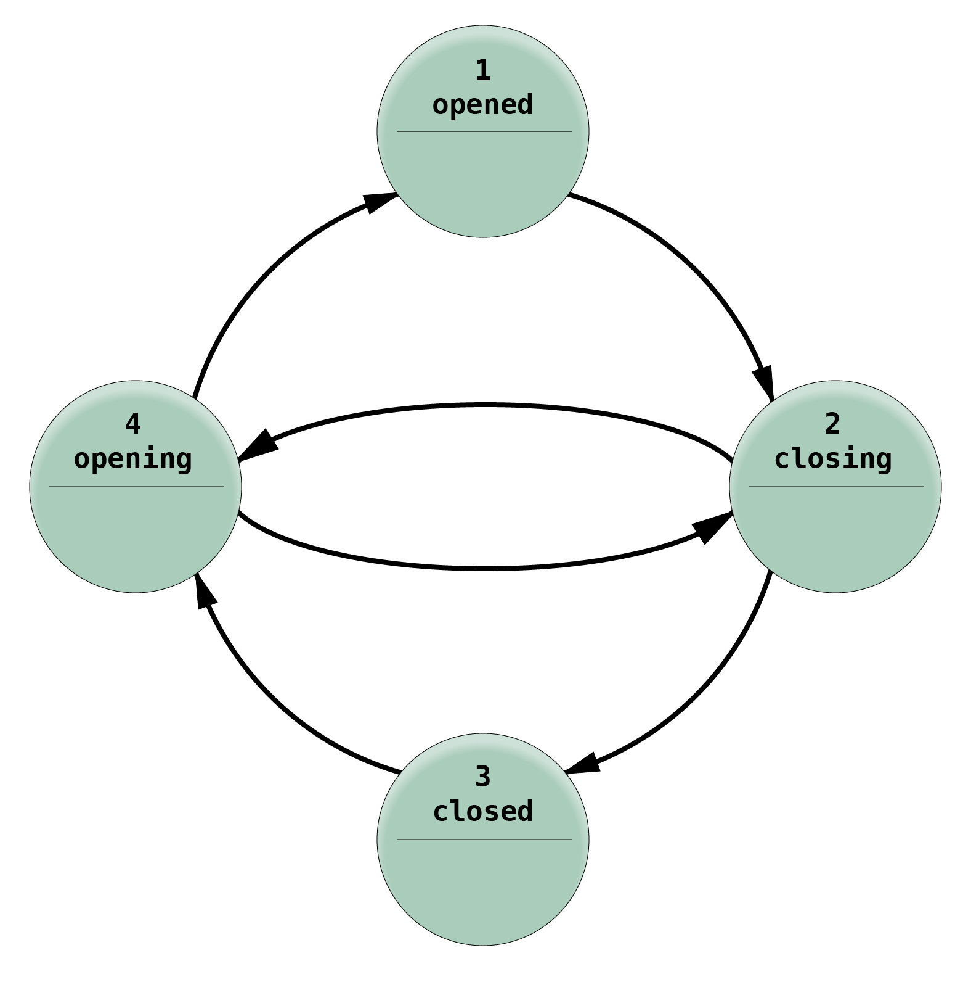
Creating a Formal Definition of Dependence
Statics
Dynamics
Program Logic
Careful File Transfer
𝚪 ⊢ e : 𝛕
e ⇝ e′
{ P } S { Q }
F
”Compile” many semantics to common
formalism (here: state machines)
Adapt definition of causation to
common formalism
Notes:
Sources:
https://www.pexels.com/photo/landscape-photography-of-green-grass-field-2684805/
https://www.pexels.com/photo/person-in-black-hoodie-riding-swing-while-raining-804474/
https://www.pexels.com/photo/green-grassy-lawn-in-cold-dew-4406352/

Slide 50
Creating a Formal Definition of Dependence
Statics
Dynamics
Program Logic
Careful File Transfer
𝚪 ⊢ e : 𝛕
e ⇝ e′
{ P } S { Q }
F
”Compile” many semantics to common
formalism (here: state machines)
Adapt definition of causation to
common formalism
Recover intuitive notion of dependence
Build dependencies
Notes:
Sources:
https://www.pexels.com/photo/landscape-photography-of-green-grass-field-2684805/
https://www.pexels.com/photo/person-in-black-hoodie-riding-swing-while-raining-804474/
https://www.pexels.com/photo/green-grassy-lawn-in-cold-dew-4406352/

Slide 51
Creating a Formal Definition of Dependence
Statics
Dynamics
Program Logic
Careful File Transfer
𝚪 ⊢ e : 𝛕
e ⇝ e′
{ P } S { Q }
F
”Compile” many semantics to common
formalism (here: state machines)
Adapt definition of causation to
common formalism
Recover intuitive notion of dependence
Build dependencies
Runtime dependencies
Notes:
Sources:
https://www.pexels.com/photo/landscape-photography-of-green-grass-field-2684805/
https://www.pexels.com/photo/person-in-black-hoodie-riding-swing-while-raining-804474/
https://www.pexels.com/photo/green-grassy-lawn-in-cold-dew-4406352/

Slide 52
Creating a Formal Definition of Dependence
Statics
Dynamics
Program Logic
Careful File Transfer
𝚪 ⊢ e : 𝛕
e ⇝ e′
{ P } S { Q }
F
”Compile” many semantics to common
formalism (here: state machines)
Adapt definition of causation to
common formalism
Recover intuitive notion of dependence
Build dependencies
Runtime dependencies
Correctness Dependencies
Notes:
Sources:
https://www.pexels.com/photo/landscape-photography-of-green-grass-field-2684805/
https://www.pexels.com/photo/person-in-black-hoodie-riding-swing-while-raining-804474/
https://www.pexels.com/photo/green-grassy-lawn-in-cold-dew-4406352/

Slide 53
Creating a Formal Definition of Dependence
Statics
Dynamics
Program Logic
Careful File Transfer
𝚪 ⊢ e : 𝛕
e ⇝ e′
{ P } S { Q }
F
”Compile” many semantics to common
formalism (here: state machines)
Adapt definition of causation to
common formalism
Recover intuitive notion of dependence
“Does not depend
on untrusted network”
Build dependencies
Runtime dependencies
Correctness Dependencies
Notes:
Sources:
https://www.pexels.com/photo/landscape-photography-of-green-grass-field-2684805/
https://www.pexels.com/photo/person-in-black-hoodie-riding-swing-while-raining-804474/
https://www.pexels.com/photo/green-grassy-lawn-in-cold-dew-4406352/

Slide 54
Reconciling “Contradictory” Advice
Static/Build Dependence
“I can remove this dependency by placing a simple delegating method on the server that hides the delegate.”
— Martin Fowler
A correctness property
“If something logical depends on the implementation, then something physical should too.”
— Robert Martin
the well-formedness property
Notes:
Quora source: https://www.quora.com/Software-Engineering-Best-Practices-What-is-the-difference-between-coupling-and-dependency

Slide 55
Also in the paper
How to define causality on programs
Formal definitions
Nonfunctional requirements (e.g.: performance dependencies)
Dependence vs. coupling

Slide 56
Conclusion
Summary
Opportunities
Semantics
Creating domain-specific definitions of dependence
Inspire tools
And give clarity on controlling dependences
Dependence
Properties
Permitted Changes
Dependence = causation
  Answers questions about fallback
  Can translate research in causality

