Slide 1
Finding Relevant Code with Causal Inference
James Koppel, MIT
Armando Solar-Lezama, MIT

Slide 2
Motivating Example
Input | Output
“Hello” | “Hello”
“World” | “World”
“NEPLS” | “NEPLS”
void main(String x) {
mystery(x);
doSomethingRandom();
}
What is mystery?
How can a program learn how to print output?

Slide 3
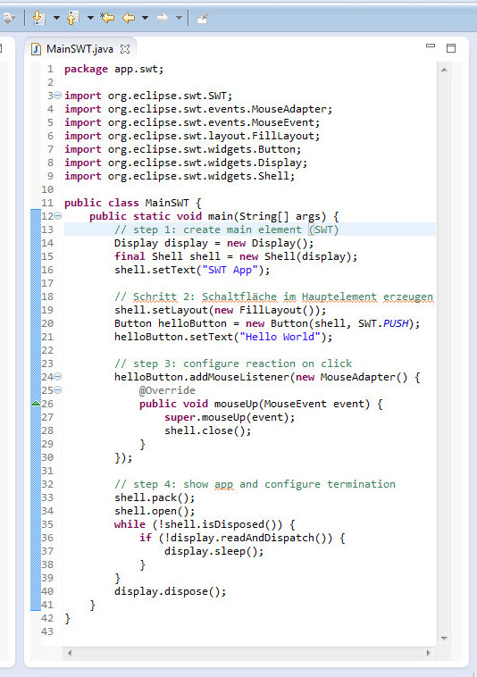
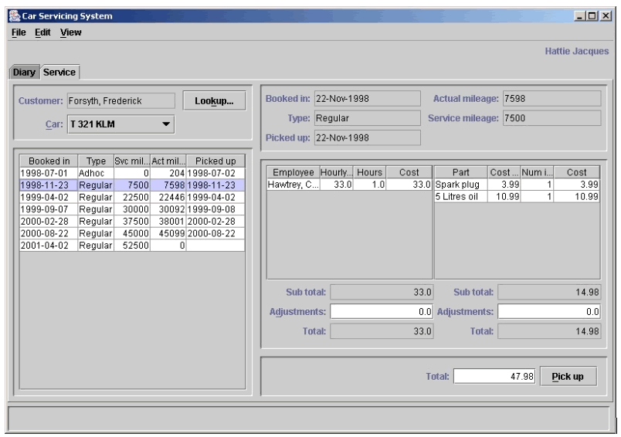
How can we tell what code causes an effect
…..without needing to understand the framework?

Slide 4
Outline
Example Problem
Abstract Setting
Causal Inference
Application

Slide 5
Outline
Example Problem
Abstracted View
Causal Inference
Application

Slide 6
Example
Framework code
User code
int val = 0;
void setOutput(k) {
val = k;
}
void main() {
int n = 0;
while (true) {
n++;
int i = randInt(0,1);
int j = randInt(0,1);
callback(i,j);
print(n+val);
}
}
void callback(i, j) {
int t = randInt(0,1);
int x = 2*i+t;
setOutput(x);
}
Does the call to setOutput affect the output of the program?

Slide 7
Approaches
Finding correlations (cheap)
Analyzing user code (cheap)
Analyzing framework code (expensive)

Slide 8
Correlation is not enough
Framework code
User code
int val = 0;
void setOutput(k) {
val = k;
}
void main() {
int n = 0;
while (true) {
n++;
int i = randInt(0,1);
int j = randInt(0,1);
callback(i, j);
}
}
void callback(i,j) {
int t = randInt(0,1);
int x = 2*i+j;
setOutput(x);
}
output (for n < 2)
 | 0 | 1 | 2 | 3 | 4
0 | ¹/₈ | ¹/₈ | 0 | 0 | 0
1 | 0 | ¹/₈ | ¹/₈ | 0 | 0
2 | 0 | 0 | ¹/₈ | ¹/₈ | 0
3 | 0 | 0 | 0 | ¹/₈ | ¹/₈
x
Version 1: print(n+val);
Version 2: print(n+2*i+j);
Can’t tell these apart

Slide 9
User code is not enough
Framework code
User code
int val = 0;
void setOutput(k) {
val = k;
}
void main() {
int n = 0;
while (true) {
n++;
int i = randInt(0,1);
int j = randInt(0,1);
callback(i, j);
}
}
void callback(i,j) {
int t = randInt(0,1);
int x = 2*i+t;
setOutput(x);
}
Version 1: print(n+val);
Version 2: print(n+2*i+j);
Still can’t tell these apart

Slide 10
Approaches
Finding correlations (cheap)
Analyzing user code (cheap)
Analyzing framework code (expensive)
Idea: Combine 1 and 2

Slide 11
Local Analysis + Data = Global Analysis

Slide 12
Outline
Example Problem
Abstracted View
Causal Inference
Application

Slide 13
Abstract Setting
Framework
F
User Code
Output
U
O
Extremes
F determines U and O
All correlation may be confounding
F has no effect on U
Correlation between U and O is causation

Slide 14
Abstract Setting
Framework
F
User Code
Output
U
O
In between
If F has a “small” effect on O, then is correlation between U and O mostly causation?
YES!

Slide 15
Outline
Example Problem
Abstracted View
Causal Inference
Application

Slide 16
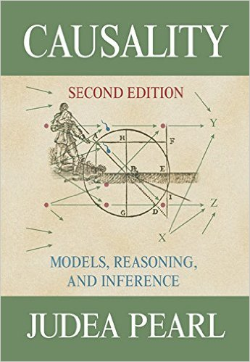
Tool: Causal Inference

Slide 17
Quantified Causal Influence
Z₂
X
Z₂=X
Y
Y=Z₁xor Z₂
Z₁
X=rand({0,1})
Z₁=X
Note I(Z₁ : Y) = 0
How can you summarize
the effect of Z₁ on Y into
a single number?

Slide 18
Quantified Causal Influence
Z₂
X
Z₂=X
Y
Y=Z₁xor Z₂
Z₁
X=rand({0,1})
Z₁=X
= number of bits of control over Y from setting Z₁

Slide 19
Outline
Example Problem
Abstracted View
Causal Inference
Application

Slide 20
Revisit: Abstract Setting
Framework
F
User Code
Output
U
O
If F has a “small” effect on O, then correlation
between U and O is mostly causation

Slide 21
Back to Example
Framework code (F)
User code (U)
int val = 0;
void setOutput(k) {
val = k;
}
void main() {
int n = 0;
while (true) {
n++;
int i = randInt(0,1);
int j = randInt(0,1);
callback(i,j);
print(n+val);
}
}
void callback(i, j) {
int t = randInt(0,1);
int x = 2*i+t;
setOutput(x);
}
Approach
Estimate I(U : O)
Estimate I(F : U)
If I(U : O) > I(F : U) , then C_{U→O} > 0
call to setOutput must affect output!
Actual Values
O
I(U : O) = 1.25 (for n<2)
I(F : U) = 1
C_{U→O} = 2

Slide 22
Summary
Using the quantified causal influence, we can extract natural experiments from program traces to determine when code causes an effect

