Slide 1
Rewriting Code in Every Language
Strategy Combinators
for Compositional Data Types
James Koppel
MIT CSAIL

Slide 2
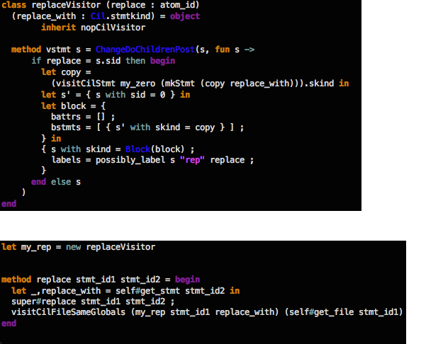
Replace a statement?
Genprog
Tarski Repair
Statement-specific
24 SLOC
Sort generic (almost)
6 SLOC
called from a 500-line traversal
in 50K lines of C infrastructure (CIL)
+ 2 SLOC language-specific machinery
and 300 lines of generic infrastructure

Slide 3
type ProgramTransformation = Program -> Program

Slide 4
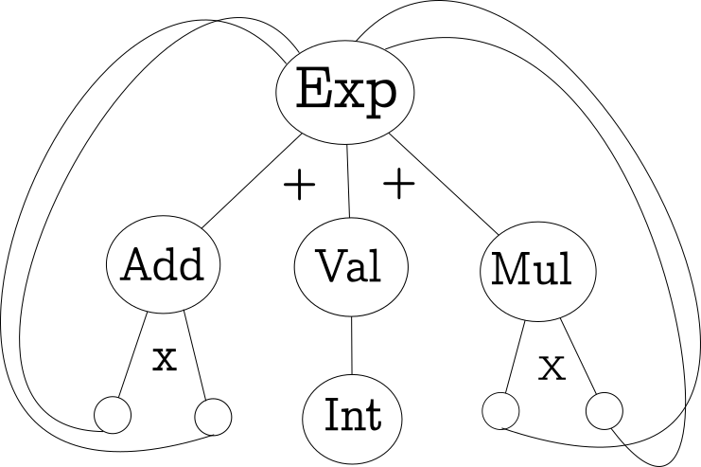
(Subtype-Arrow)
data Exp = Add Exp Exp
| Val Int
| Mul Exp Exp

Slide 5
The Expression Problem is a new name for an old problem. The goal is to define a datatype by cases, where one can add new cases to the datatype and new functions over the datatype, without recompiling existing code, and while retaining static type safety (e.g., no casts).
Phillip Wadler, 1998

Slide 6
Modular Representation
Data types á la carte
Generic, Mutually-Recursive Datatypes
Compositional Data Types
Modular Operations
Recursion Schemes
Updatable Fold Algebras
Strategic Programming
Putting It Together: compstrat

Slide 7
Modular Representation
Data types á la carte
Generic, Mutually-Recursive Datatypes
Compositional Data Types
Modular Operations
Recursion Schemes
Updatable Fold Algebras
Strategic Programming
Putting It Together: compstrat

Slide 8
“Functional Pearl: Data types á la carte”
Wouter Swierstra, 2008

Slide 9
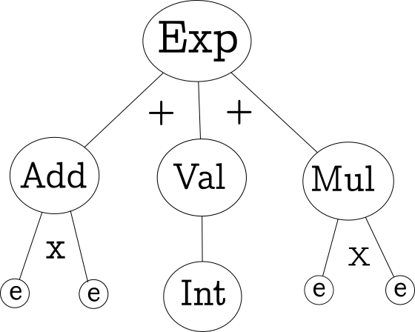
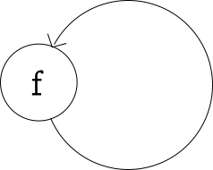
Untying the knot
data ExpF e = Add e e
| Val Int
| Mul e e
data Fix f = Fix (f (Fix f))
Fix ExpF ≅ Exp

Slide 10
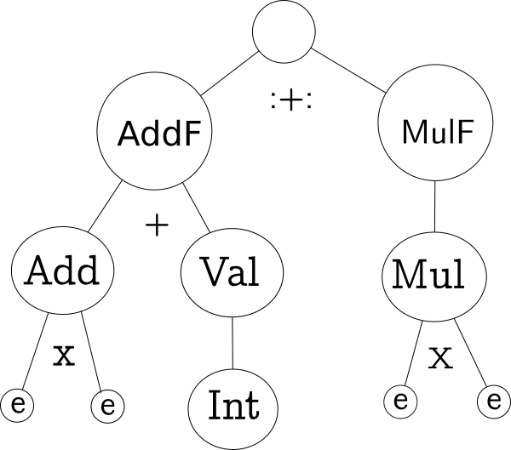
Sum of Products
data (f :+: g) e = Inl (f e) | Inr (g e)
data AddF e = Add e e
| Val Int
data MulF e = Mul e e
type ExpF e = (AddF :+: MulF) e
Fix ExpF ≅ Exp

Slide 11
Creating Terms
Fix (Inl (Add (Fix (Inr (Mul (Fix (Inl (Val 80))) (Fix (Inl (Val 5))))))(Fix (Inl (Val 5)))))
add (mul (val 80) (val 5)) (val 4)

Slide 12
Want: add (mul (val 80) (val 5)) (val 4)
class (f :<: g) where
inj :: f a -> g a
instance (f :<: f) where
inj x = x
instance (f :<: (f :+: g)) where
inj x = Inl x
instance (f :<: g) => (f :<: (h :+: g)) where
inj x = Inr (inj x)
inject :: (f :<: g) => f (Fix g) -> Fix g
inject x = Fix (inj x)
add = inject ◦ Add
mul = inject ◦ Mul
val = inject ◦ val
Notes:
NOT f (Fix f)

Slide 13
How to Program?
eval :: Exp -> Int
eval (Val n) = n
eval (Add a b) = (eval a) + (eval b)
eval (Mul a b) = (eval a) * (eval b)

Slide 14
How to Program?
Pattern Matching
Recursion

Slide 15
How to Program?
Pattern Matching
class Eval f where
eval :: f Int -> Int
instance Eval AddF where
eval (Val n) = n
eval (Add a b) = a + b
instance Eval MulF where
eval (Mul a b) = a * b
instance (Eval f, Eval g) => Eval (f :+: g) where
eval (Inl x) = eval x
eval (Inr x) = eval x

Slide 16
How to Program?
Recursion
class Functor f where
fmap:: (a -> b) -> (f a -> f b)
instance Functor AddF where
fmap f (Val n) = Val n
fmap f (Add a b) = Add (f a) (f b)
instance Functor MulF where
fmap f (Mul a b) = Mul (f a) (f b)
instance (Functor f, Functor g) => Functor (f :+: g) where
fmap f (Inl x) = Inl (fmap f x)
fmap f (Inr x) = Inr (fmap f x)

Slide 17
How to Program?
Recursion
cata :: (Functor f) => (f a -> a) -> Fix f -> a
cata f t = f (fmap (cata f) t)
evalTerm :: Fix (AddF :+: MulF) -> Int
evalTerm = cata eval

Slide 18
Multi-Sorted?
data Exp = Val Int
| Add Exp Exp
| Mul Exp Exp
data Decl = Assign Var Exp
| Seq Decl Decl
type Var = String
data AddF d e = Val Int
| Add e e
data MulF d e = Mul e e
data DeclF d e = Assign Var e
| Seq d d
type Var = String
data (f :+:₂ g) d e = Inl₂ (f d e) | Inr₂ (g d e)
data Fix₂₁ f g = Fix₂₁ (f (Fix₂₁ f g) (Fix₂₂ f g))
data Fix₂₂ f g = Fix₂₁ (g (Fix₂₁ f g) (Fix₂₂ f g))
Fix₂₂ (AddF :+:₂ MulF) DeclF ≅ Decl

Slide 19
“Generic programming with fixed points for
mutually recursive datatypes”
A. Rodriguez et al, 2009

Slide 20
General Form of Fixpoints
Fix :: ((* -> *) -> *)
Fix₂ :: ((* -> * -> *) -> (* -> * -> *) -> *)²
.
.
.
Fix_{n} :: ((*^{n} -> *)^{n} -> *)^{n}
(*)^{n} ≅ (n -> *)
≅ n -> (n -> (n -> *) -> *) -> *
≅ ((n -> *) -> (n -> *)) -> (n -> *)
≈ ((* -> *) -> (* -> *)) -> (* -> *)

Slide 21
“Compositional Datatypes”
P. Bahr and T. Hvitved, 2011
Notes:
Really just data types a la carte with stuff, but big idea is…

Slide 22
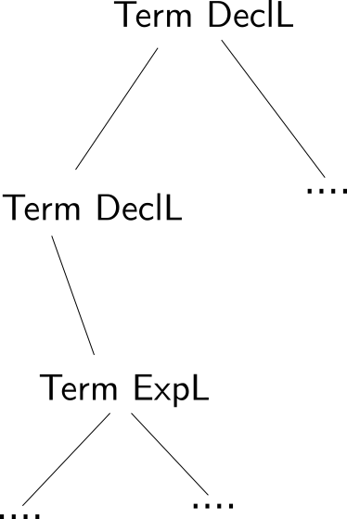
Multi-Sorted CDTs
data DeclL; data ExpL;
data DeclF e l where
Assign :: Var -> e ExpL -> DeclF e DeclL
Seq :: e DeclL -> e DeclL -> DeclF e DeclL
data ExpF e l where
Val :: Int -> ExpF e ExpL
Add :: e ExpL -> e ExpL -> ExpF e ExpL
Mul :: e ExpL -> e ExpL -> ExpF e ExpL
data (f :+: g) e l = Inl (f e l) | Inr (g e l)
data Term f l = Term (f (Term f l) l)
Term (ExpF :+: DeclF) DeclL ≅ Decl
Term (ExpF :+: DeclF) ExpL ≅ Exp

Slide 23
Annotations and Holes
data (f :&: c) e l = c :&: (f e l)
Labeled terms:
Term ((ExpF:+: DeclF) :&: Int) DeclL
data Context f l a = Term (f (Context f l a) l)
| Hole a
Terms with holes:
Context (ExpF :+: DeclF) DeclL a
Notes:
The way I’ve written things here, need separate functions for terms and contexts. Actual definition doesn’t.

Slide 24
Modular Representation
Data types á la carte
Generic, Mutually-Recursive Datatypes
Compositional Data Types
Modular Operations
Recursion Schemes
Updatable Fold Algebras
Strategic Programming
Putting It Together: compstrat

Slide 25
Desiderata
Generic
Supports type-generic operations
Specific
Supports type-specific operations
Reusable
Fragments can be combined in different ways
Robust
Can change type without changing code
Control
Fine-grained control over traversal order
.
.
.

Slide 26
Non-Solutions

Slide 27
“By-Hand”
Generic
Supports type-generic operations
Specific
Supports type-specific operations
Reusable
Fragments can be combined in different ways
Robust
Can change type without changing code
Control
Fine-grained control over traversal order
eval :: Exp -> Int
eval (Val n) = n
eval (Add a b) = (eval a) + (eval b)
eval (Mul a b) = (eval a) * (eval b)
✔️
✔️
.
.
.

Slide 28
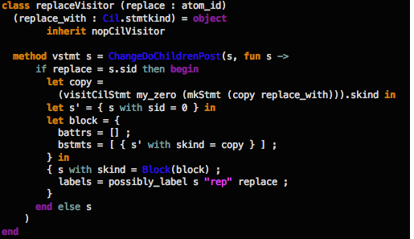
Visitor Pattern
Generic
Specific
Reusable
Robust
Control
✔️
✔️
.
.
.

Slide 29
Uniform Representation + By-Hand
✔️
Generic
Supports type-generic operations
Specific
Supports type-specific operations
Reusable
Fragments can be combined in different ways
Robust
Can change type without changing code
Control
Fine-grained control over traversal order
data ASTNode = ASTNode {
name :: String
, children :: [ASTNode]
}
✔️
✔️
.
.
.

Slide 30
“Functional Programming with Bananas,
Lenses, Envelopes, and Barbed Wire”
Erik Meijer et al, 1991

Slide 31
Remember Catamorphisms?
class Eval f where
eval :: f Int -> Int
instance Eval AddF where
eval (Val n) = n
eval (Add a b) = a + b
. . . (other cases) . . .
cata :: (Functor f) =>
(f a -> a) -> Fix f -> a
cata f t = f (fmap (cata f) t)
evalTerm :: Fix (AddF :+: MulF) -> Int
evalTerm = cata eval
.
.
.

Slide 32
Enhancing Catamorphisms
cata :: (Functor f) =>
(f a -> a) -> Fix f -> a
cata f t = f (fmap (cata f) t)
Rewrites?
Use f (Fix f) -> Fix f
type Program = Fix LangF
substVar’ :: String -> Program -> f Program -> Program
substVar :: String -> Program -> Program -> Program
substVar name replace = cata (substVar’ name replace)

Slide 33
Enhancing Catamorphisms
cata :: (Functor f) =>
(f a -> a) -> Fix f -> a
cata f t = f (fmap (cata f) t)
Context?
Use (c -> a)
typeCheck’ :: LangF (Env -> Type) -> Env -> Type
typeCheck :: Fix LangF -> Env -> Type
typeCheck = cata typecheck’
Failure? State? Outputs?
Use monads
safeEval’ :: LangF (Maybe Int) -> Maybe Int
Default cases?
With generic ways of combining,
class Foldable f where
fold :: (Monoid m) => f m -> m

Slide 34
Recursion Scheme Zoo
catamorphism :: (f a -> a) -> Fix f -> a
Fold: breaking down layer-by-layer
anamorphism :: (a -> f a) -> a -> Fix f
Unfold: building up layer-by-layer
hylomorphism :: (a -> f a) -> (f b -> b) -> a -> b
General recursion: Build up a tree of subproblems, then tear it down
paramorphism :: (f (Fix f, a) -> a) -> Fix f -> a
Primitive recursion: Fold with original value
apomorphism :: (a -> f (Either a (Fix f))) -> a -> Fix f
Unfold with short-circuiting
zygomorphism :: (f b -> b) -> (f (a, b) -> a) -> Fix f -> a
Fold with a helper function
histomorphism :: (f (Fix (a :&: f)) -> a) -> Fix f -> a
Fold with previous results
futumorphism :: (a -> Context f a) -> a -> Fix f
Unfold, multiple layers at a time
.
.
.

Slide 35
Recursion Schemes
✔️
Generic
Supports type-generic operations
Specific
Supports type-specific operations
Reusable
Fragments can be combined in different ways
Robust
Can change type without changing code
Control
Fine-grained control over traversal order
✔️
✔️
✔️
.
.
.

Slide 36
“Dealing with Large Bananas”
Ralf Laemmel, Joost Visser, Jan Kort, 2000

Slide 37
Updatable Fold Algebras
type Cata e = Cata {
add :: e -> e -> e
, val :: Int -> e
, mul :: e –> e -> e
}
data Exp = Add Exp Exp
| Val Int
| Mul Exp Exp
Idea: Program with Cata -> Cata

Slide 38
Updatable Fold Algebras
Idea: Program with Cata -> Cata
crush :: (Monoid e) => Cata e
crush = Cata {
add = \x y -> x ⊕ y
, val = \x -> mempty
, mul = \x y -> x ⊕ y
}
c
collectVals:: Exp -> [Int]
collectVals = fold (crush { val=\x -> [x] })
countMul:: Exp -> Int
countMul = fold (crush { mul=\x y -> x + y + 1 })

Slide 39
Updatable Recursion Schemes
✔️
Generic
Supports type-generic operations
Specific
Supports type-specific operations
Reusable
Fragments can be combined in different ways
Robust
Can change type without changing code
Control
Fine-grained control over traversal order
✔️
✔️
✔️
✔️
.
.
.

Slide 40
“Stratego: A Language for Program Transformation
Based on Rewriting Strategies”
Eelco Visser, 2001
“The Essence of Strategic Programming”
Ralf Laemmel, Eelco Visser, Joost Visser, 2002

Slide 41
Strategic Programming
General setup
Write generic actions called “strategies”
Combine with strategy combinators

Slide 42
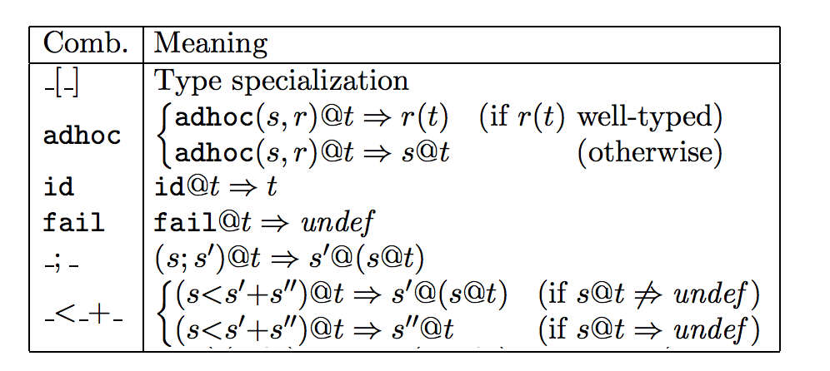
Strategic Programming
Idea #1: Failure and type-casing allow combination
(s@t means “strategy s applied to t”)

Slide 43
Strategic Programming
Idea #2: Create traversal strategies
from one-layer traversals
(s@t means “strategy s applied to t”)

Slide 44
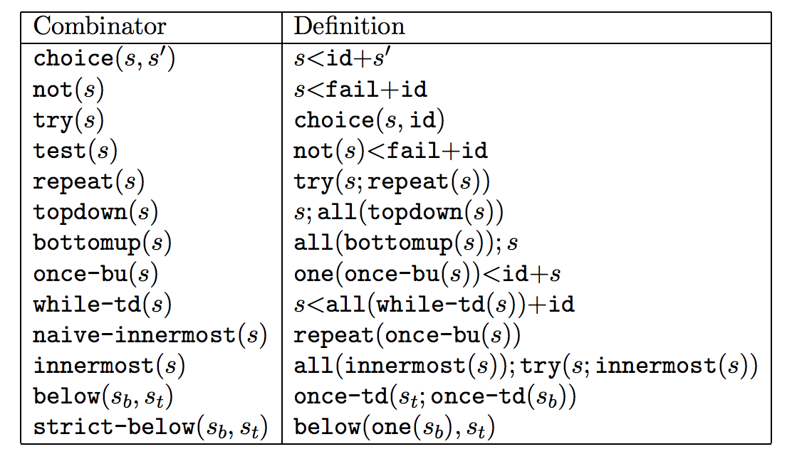
Strategic Programming

Slide 45
Strategic Programming
✔️
Generic
Supports type-generic operations
Specific
Supports type-specific operations
Reusable
Fragments can be combined in different ways
Robust
Can change type without changing code
Control
Fine-grained control over traversal order
✔️
✔️
✔️
✔️
.
.
.

Slide 46
Strategic Programming
✔️
Generic
Supports type-generic operations
Specific
Supports type-specific operations
Reusable
Fragments can be combined in different ways
Robust
Can change type without changing code
Control
Fine-grained control over traversal order
Type-safe
✔️
✔️
✔️
✔️
.
.
.

Slide 47
Modular Representation
Data types á la carte
Generic, Mutually-Recursive Datatypes
Compositional Data Types
Modular Operations
Recursion Schemes
Updatable Fold Algebras
Strategic Programming
Putting It Together: compstrat

Slide 48
Functional Strategic Programming
Library | Paper | Authors | Year | Encoding
Strafunski | Typed Combinators for Generic Traversal | Ralf Laemmel, Joost Visser | 2003 | (Monad m) => ∀x. Data x => x -> m x
RecLib | A Generic Recursion Toolbox for Haskell | Deling Ren, Martin Erwig | 2006 | ∀x. Data x => c -> a -> x -> Maybe (a, x)
KURE | A Haskell Hosted DSL for Writing Transformation Systems | Andy Gill | 2007 | (Monad m) => c -> G -> m G where G = GExp Exp | GDecl Decl | ….
Problem: Dynamically typed

Slide 49
“compstrat: Strategy combinators for
compositional data types”
James Koppel, 2013
http://hackage.haskell.org/package/compstrat

Slide 50
compstrat
Insight: Compositional data types let us type strategy
combinators
type Rewrite m f l = (Monad m) => f l -> m (f l)
type GRewrite m f = (Monad m) => ∀l. f l -> m (f l)
Need one extra ingredient
dynProj :: (DynCase f l) => f l’ -> Maybe (f l)

Slide 51
compstrat: Example
Generic Delete
delete' :: (constraints) => Rewrite m (Term f) StmtL
delete' _ = return emptyStatement
targetLabel :: (constraints) => Label
-> Rewrite m (Term f) StmtL
-> Rewrite (MaybeT m) (Term f) StmtL
targetLabel l f t
| labelMatch l t = return (f t)
| otherwise = fail
delete :: (constraints) => Label -> Term f l -> Term f
delete l = tryR $ onebuR $ promoteRF $ targetLabel l delete’

Slide 52
Functional Strategic Programming
✔️
Generic
Supports type-generic operations
Specific
Supports type-specific operations
Reusable
Fragments can be combined in different ways
Robust
Can change type without changing code
Control
Fine-grained control over traversal order
Type-safe
✔️
✔️
✔️
✔️
✔️
.
.
.

Slide 53
Limitations
Lost Precision
Stating Constraints

Slide 54
There are close to 500 programming languages used to develop applications. McCabe & Associates had made a huge investment in developing parsers for 23 of these languages. 500 would be insurmountable. Thus, the 500-language problem is the most prominent impediment to constructing tools to analyze and modify existing software assets.
Ralf Laemmel, 2001, “Cracking the 500-language problem”
(paraphrased)
My claim
When a tool can only be built for 1% of the market, we don’t get 100x fewer tools; we get none.

Slide 55
“compstrat: Strategy combinators for
compositional data types”
http://hackage.haskell.org/package/compstrat

